Slide 1

Magnons
in Ferromagnets
Julian Beisch
Konstanz, 17.12.2024

Slide 2
Motivation
Current computing
Electronics
Information by moving electrons (charge)
But they scatter Joule heating

Slide 3
Motivation
Current computing
Electronics
Information by moving electrons (charge)
But they scatter Joule heating
Another property of electrons: spin
Spintronics
Make currents with spins, but how ?
Caveat
Spins depicted as arrows is just a semi-classical approximation of an otherwise quantum mechanical expectation distribution

Slide 4
Classification
Bound e⁻
Quasi-free e⁻
Scope
Dia
Lamor Diamagnetism
Landau
Diamagnetism
Para
Langevin Paramagnetism
Pauli
Paramagnetism
IM
Cooperative Magnetism
Band Ferromagnetism
Notes:
Gucken uns gleich wechselwirkenden Magnetismus an, vorher guckt ihr euch aber die Interaktion eines Spins mit einem Feld an

Slide 5
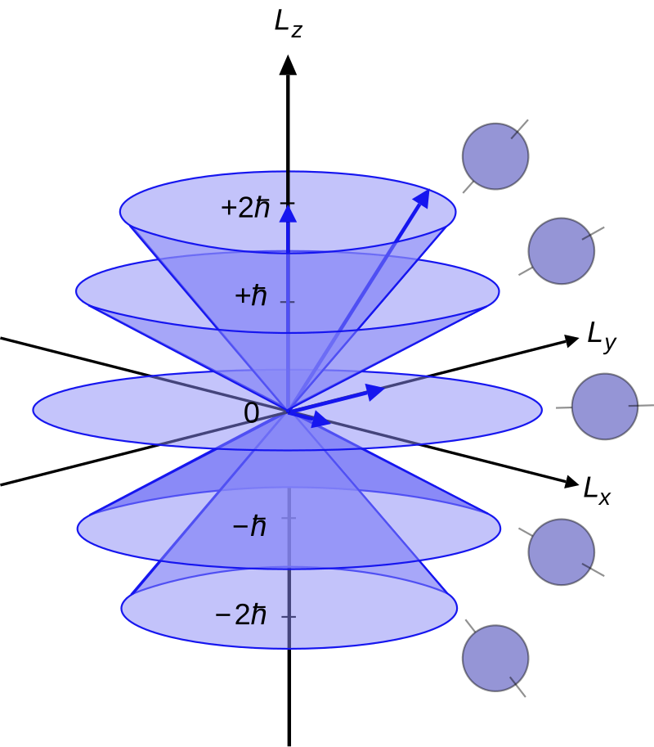
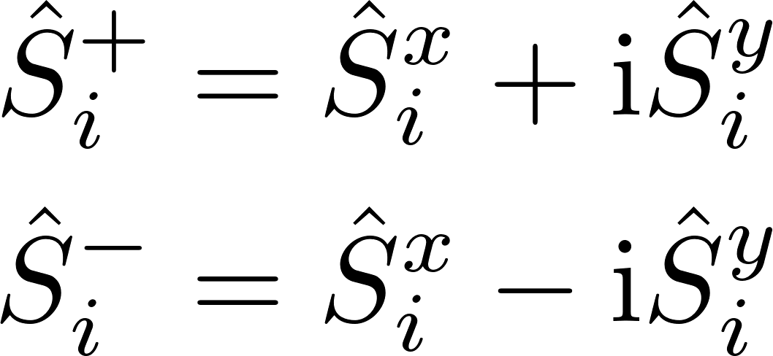
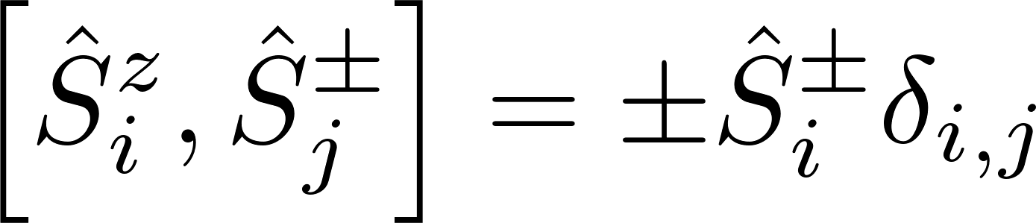
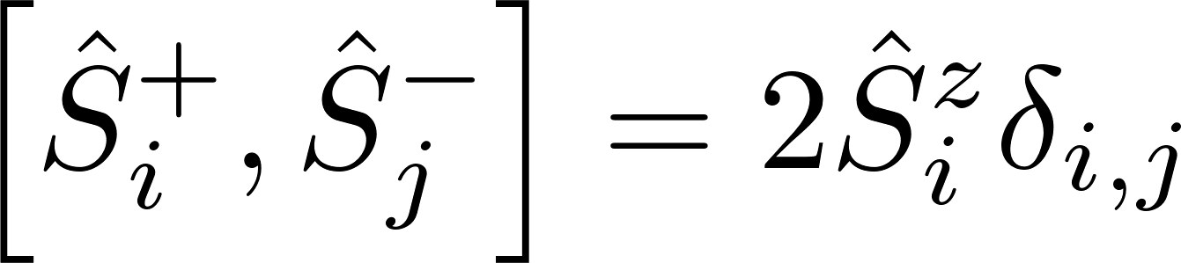
Spin-operators
Spin-operators
For S = 2
Wikipedia.com
Notes:
We repeat them here since they are quite important for this talk
They fulfill the angular momentum algebra

Slide 6
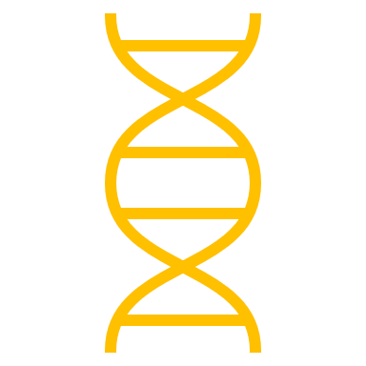
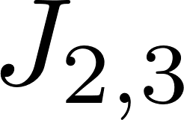




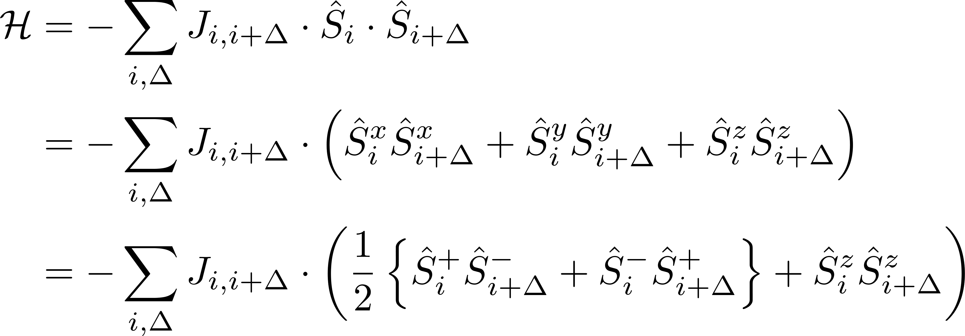
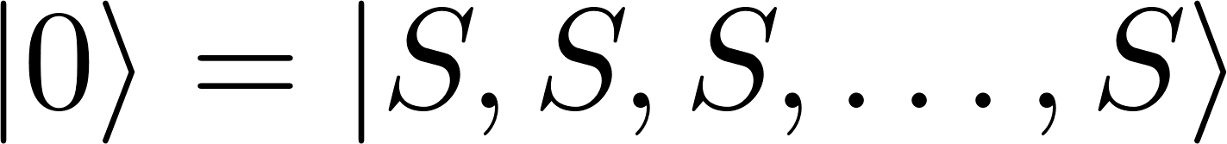
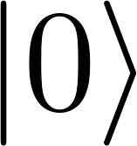
Heisenberg Theory of Ferromagnetism
Groundstate
W.Heisenberg Z.Physik 49, 619-636, (1928)

Slide 7

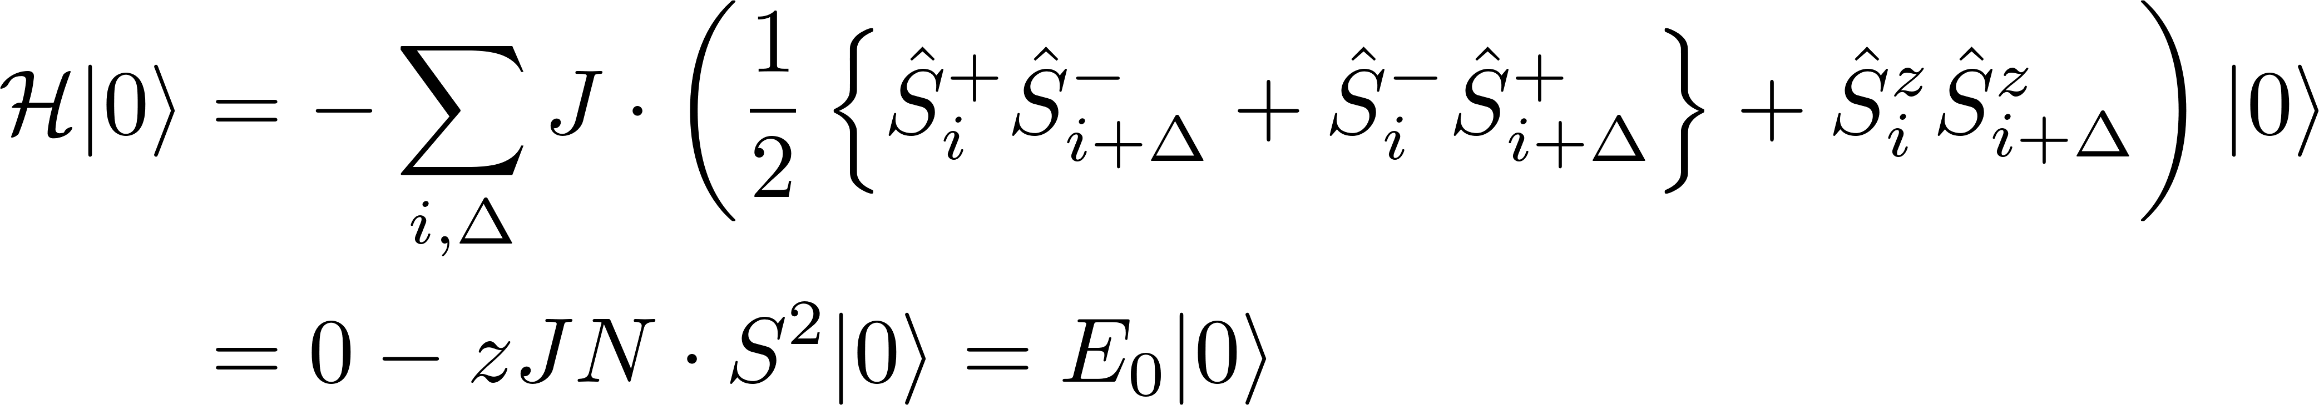
Heisenberg Theory of Ferromagnetism
Groundstate
An eigenstate, with the eigenenergy
W.Heisenberg Z.Physik 49, 619-636, (1928)
Notes:
½ due to double counting
For a chain like depicted with only nearest neighbour interaction we get a coordination number of z = 2 hence the factor cancel

Slide 8
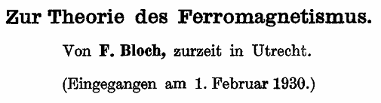
Bloch Theory of Ferromagnetism
Excitations
Groundstate
How do excitations of this state look like?
F.Bloch. Z.Physik 61, 206-219 (1930)
Notes:
The same question was asked by Felix Block
He found several low-lying excited states
We will now obtain the same result as him, but we will use a more modern path

Slide 9
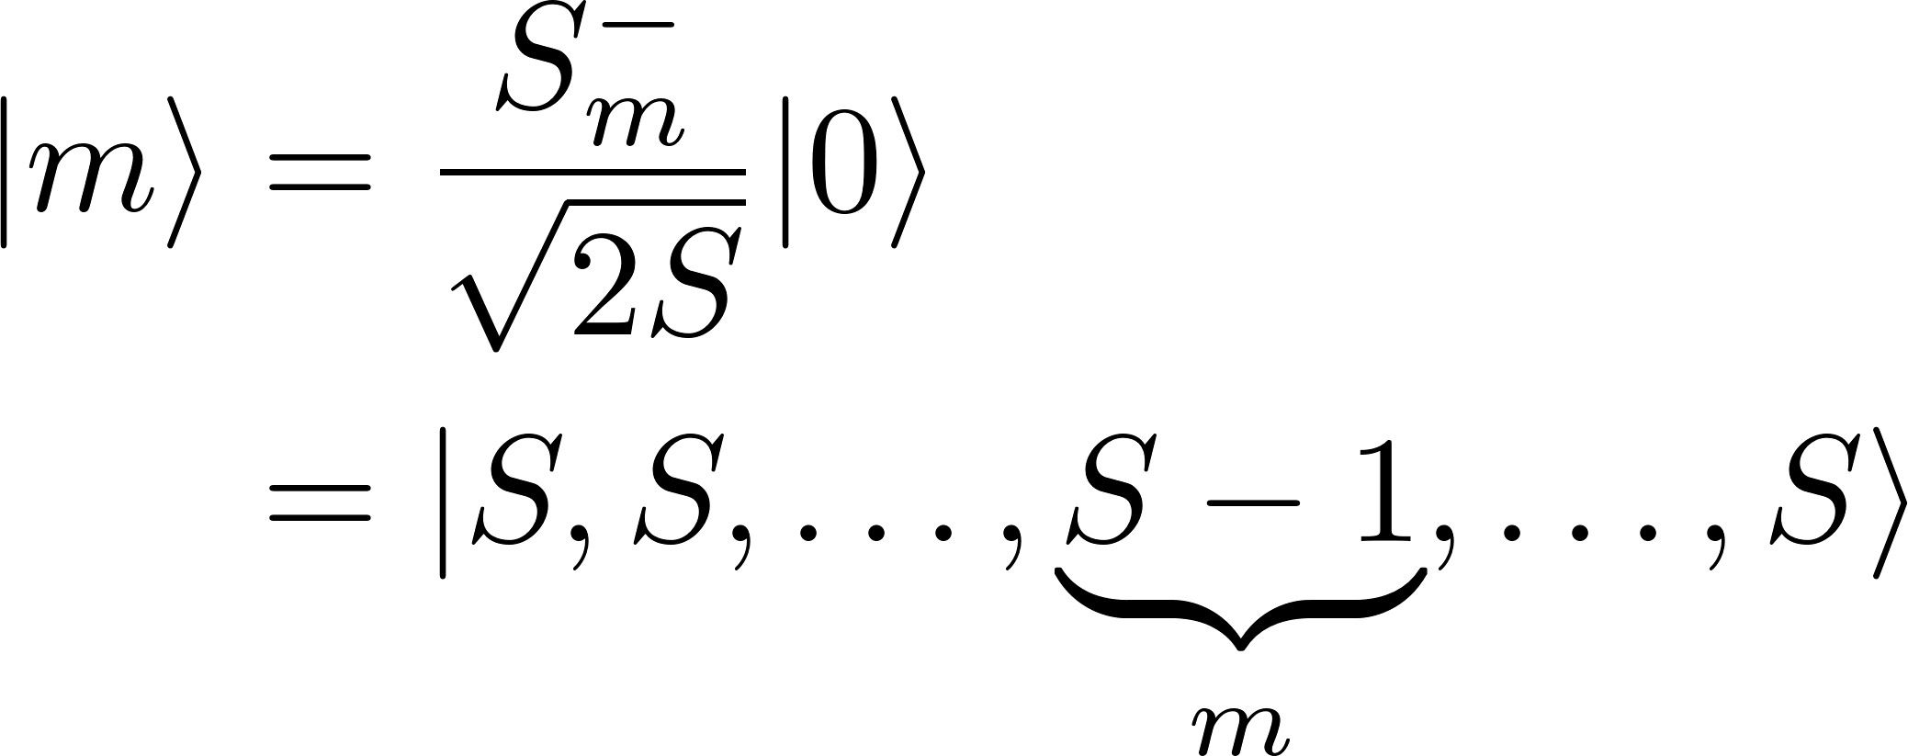
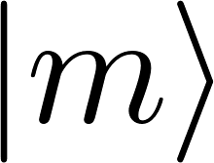
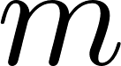
Bloch Theory of Ferromagnetism
Excitations
His approach was to consider one
flipped spin
Not an eigenstate anymore
Notes:
Flipped of course only if S = ½ but otherwise tilted
Not an eigenstate anymore, which we can quickly calculate

Slide 10
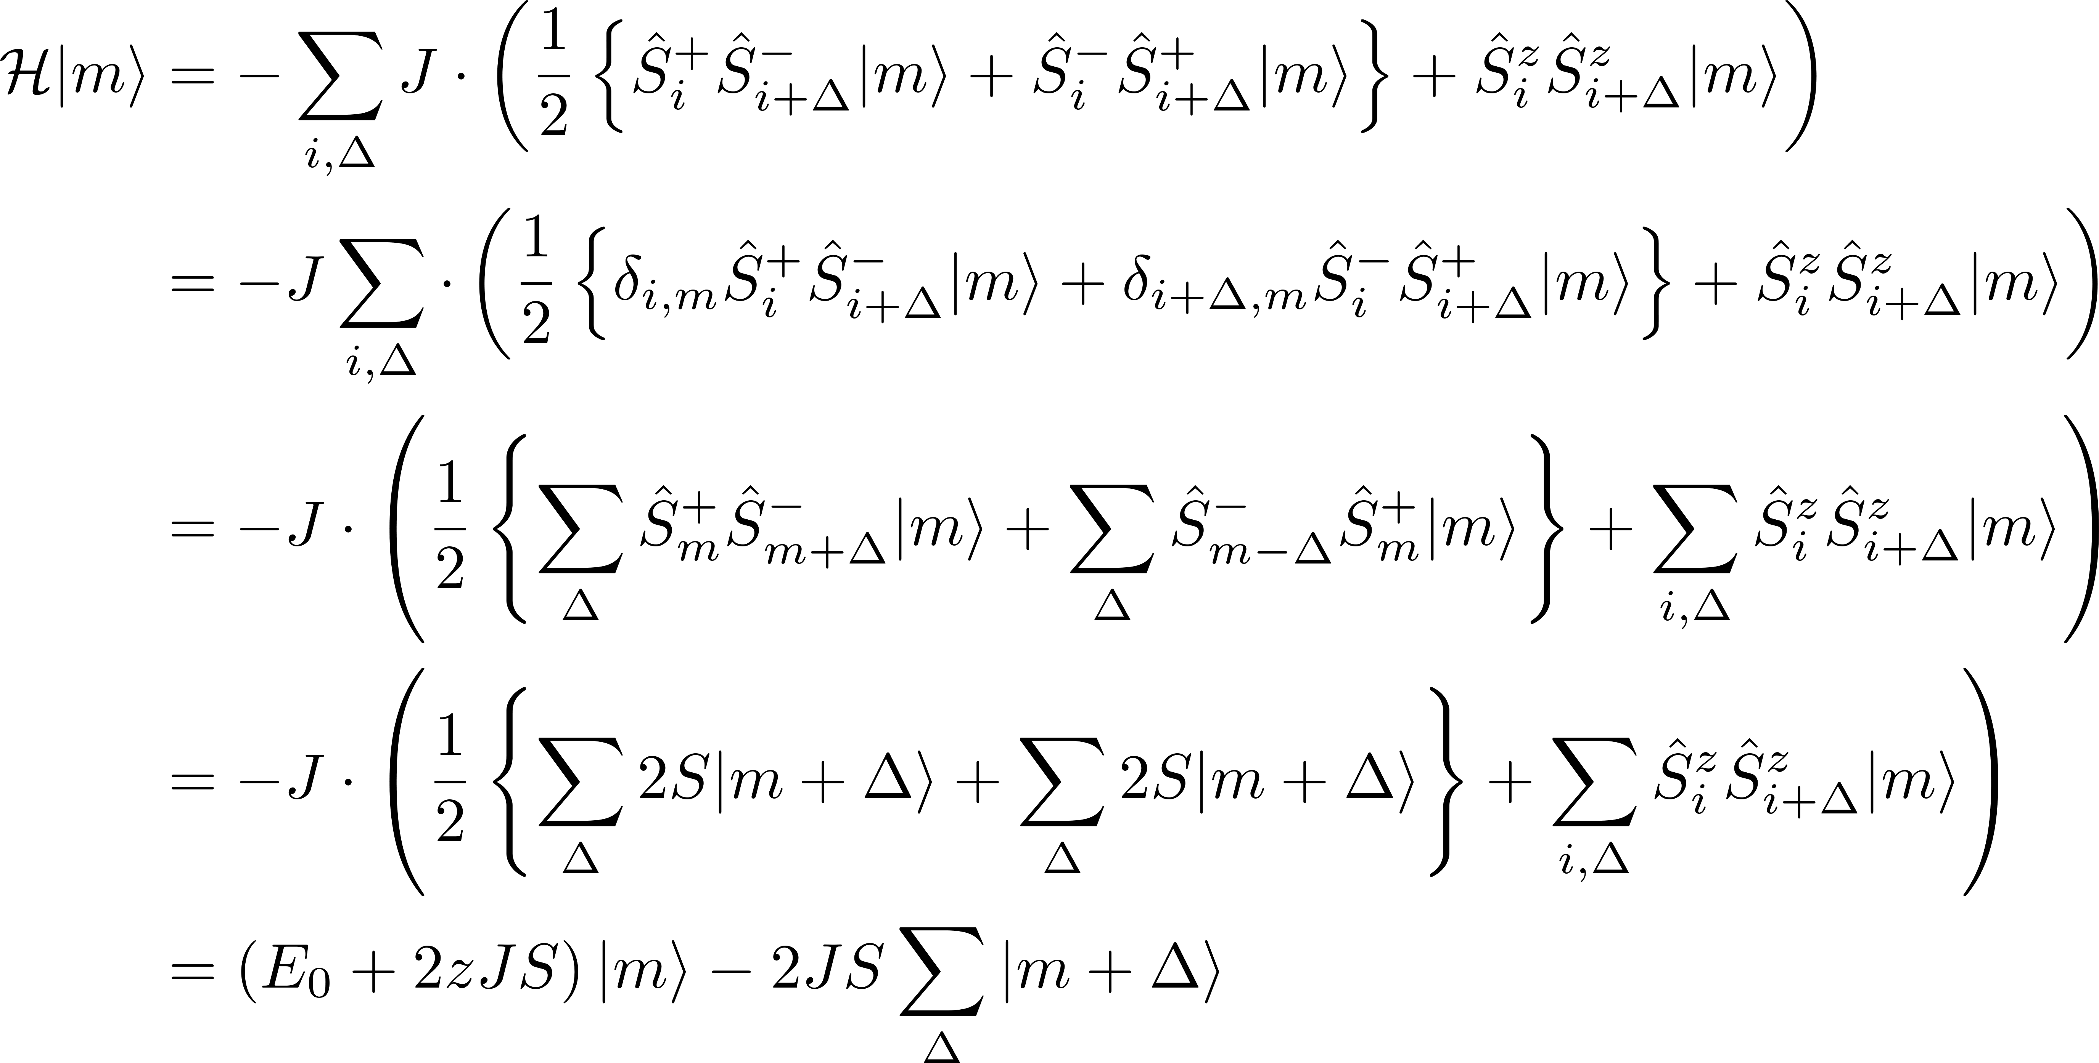
Bloch Theory of Ferromagnetism
Excitations
His approach was to consider one
flipped spin
Not an eigenstate anymore
E.Rastelli, Statistical Mechanics of Magnetic Excitations (2013)
Notes:
2S because of eigenvalues of the spin operators
We can go from m – delta to m + delta, since we assume that delta is symmetric around zero
Same as in enrico rastelli

Slide 11
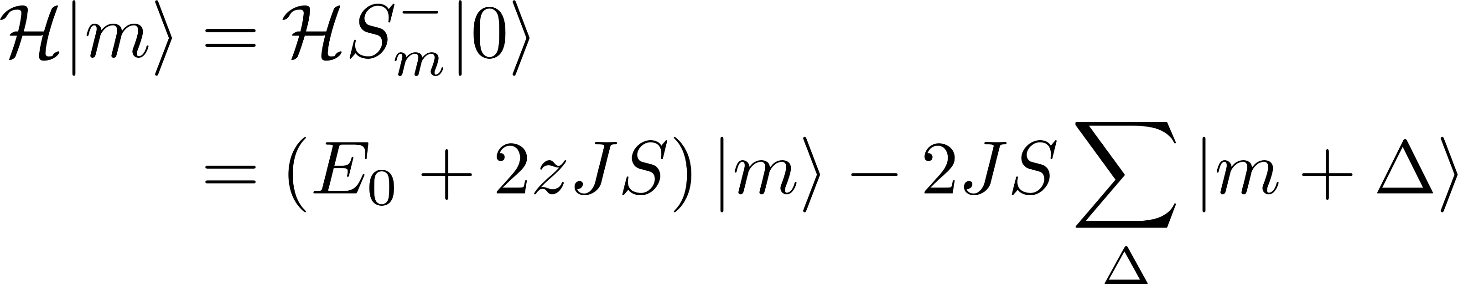
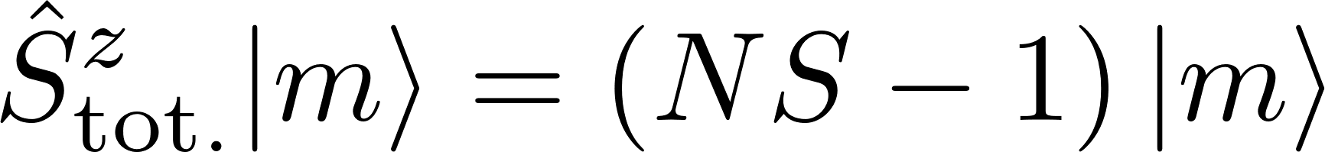
Bloch Theory of Ferromagnetism
Search for Eigenstates
Not an eigenstate anymore.
The total magnetization was reduced by 1!
Notes:
Indepent of the fact that the picture is for s=1/2

Slide 12
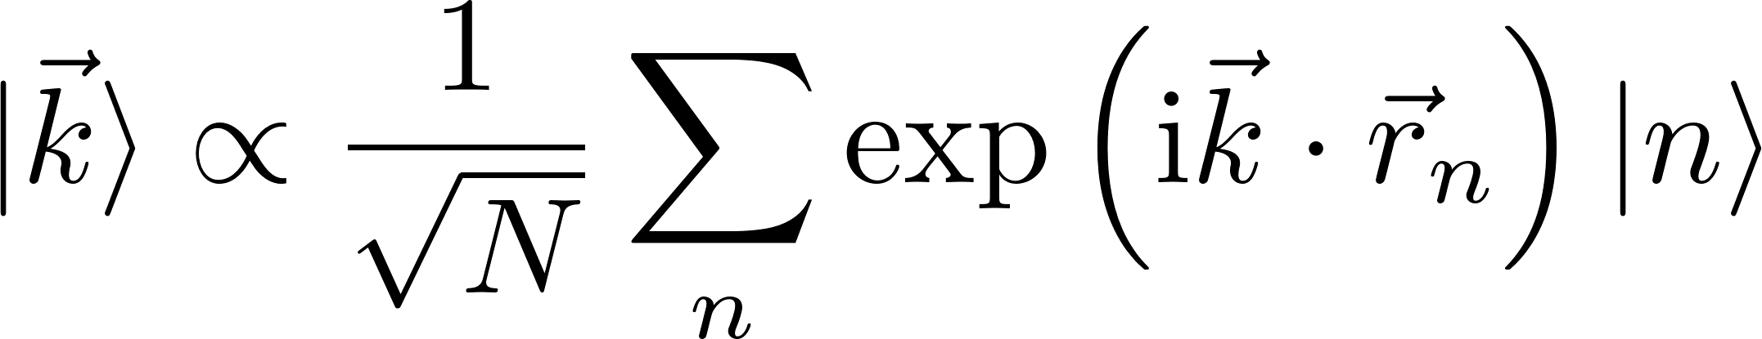
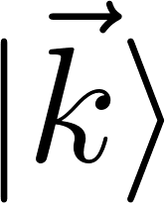
Bloch Theory of Ferromagnetism
Search for eigenstates
Not an eigenstate anymore.
The total magnetization was reduced by 1!
Hence we can guess an eigenstate
Notes:
But if we can see a linear combination of states could be what we want.
WE want the first excitation to be a eigenstate with a higher energy and a reduced magnetization.
This is a bit similiar to a coherent state, but also something we already saw in several lectures.

Slide 13
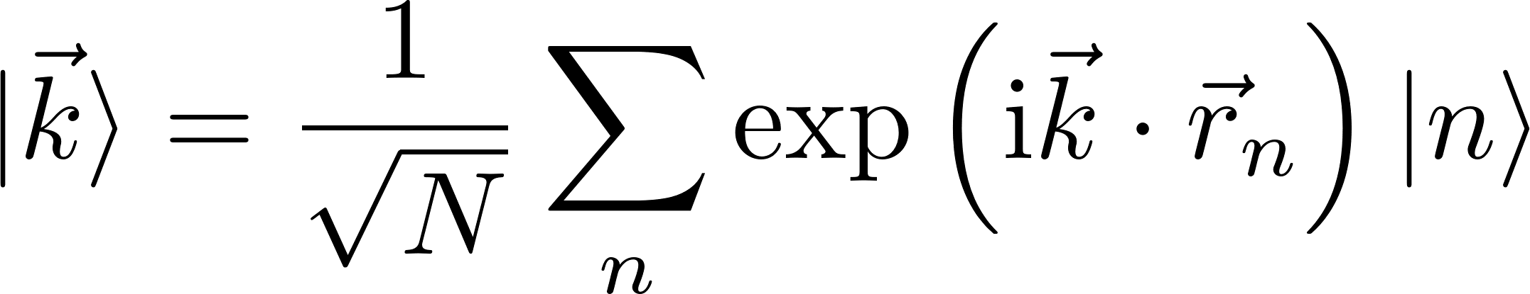
Bloch Theory of Ferromagnetism
Search for eigenstates
Not an eigenstate anymore.
The total magnetization was reduced by 1!
Hence we can guess an eigenstate
Notes:
|n> means that the spin at site n is flipped/tilted
Thus we have a superposition of where each titled spin is
|k> states are orthonormal

Slide 14
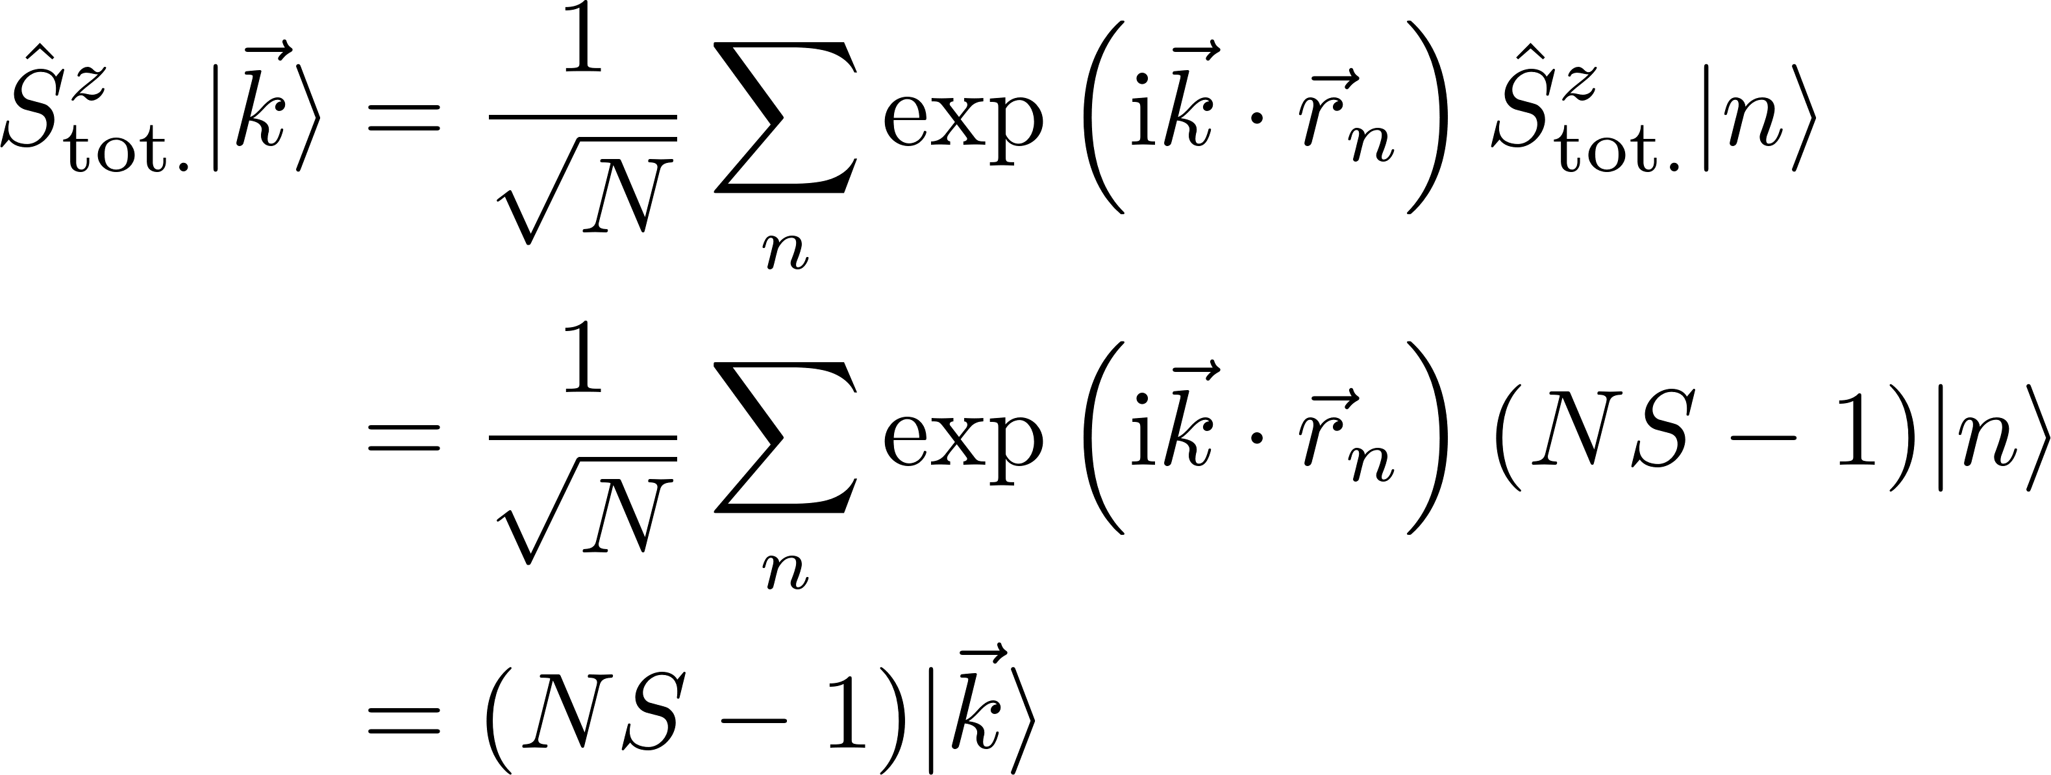
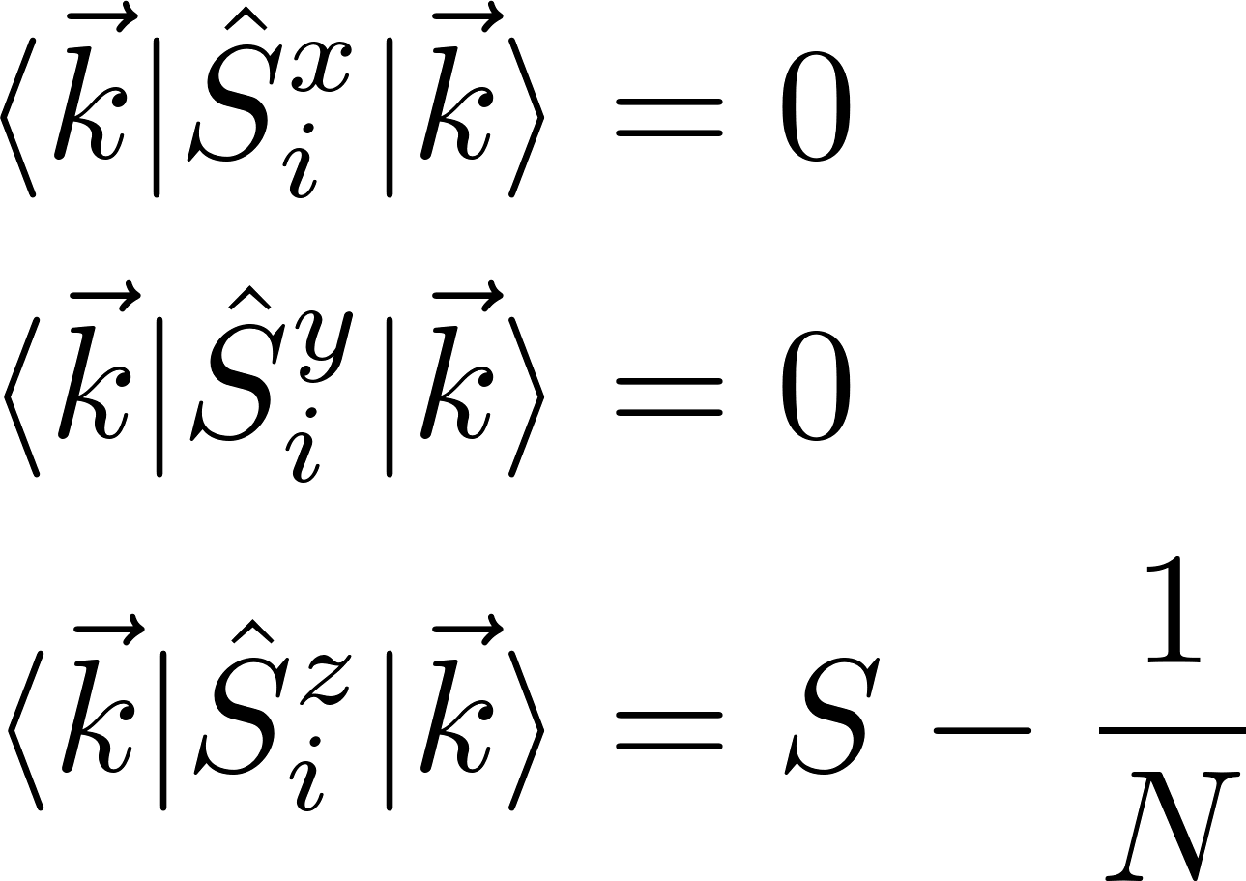
Bloch Theory of Ferromagnetism
Properties of the eigenstates
The total magnetization is reduced
As well as an increase in energy
But the average x and y component are still zero?
Notes:
The total magnetization in z is reduced, but the average x and y component are still zero? How can that be?
We can also see here that the z-compontne for a site I seems to be only reduced by 1/N instead of 1

Slide 15
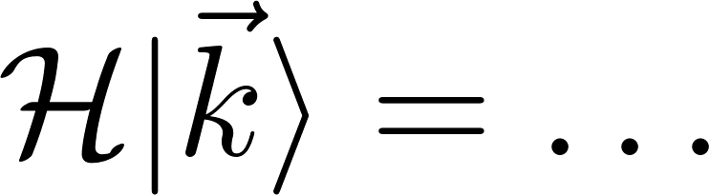
Bloch Theory of Ferromagnetism
Properties of the eigenstates
The total magnetization is reduced
As well as an increase in energy

Slide 16
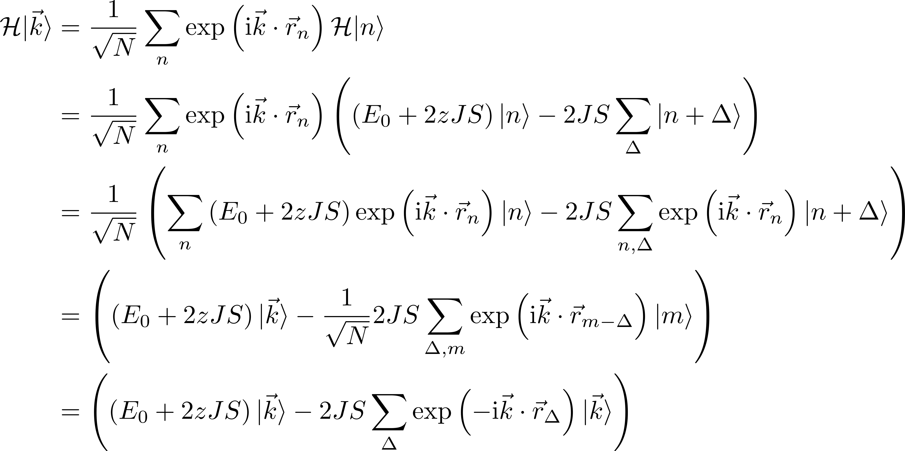
Ferromagnetic Dispersion relation

Slide 17
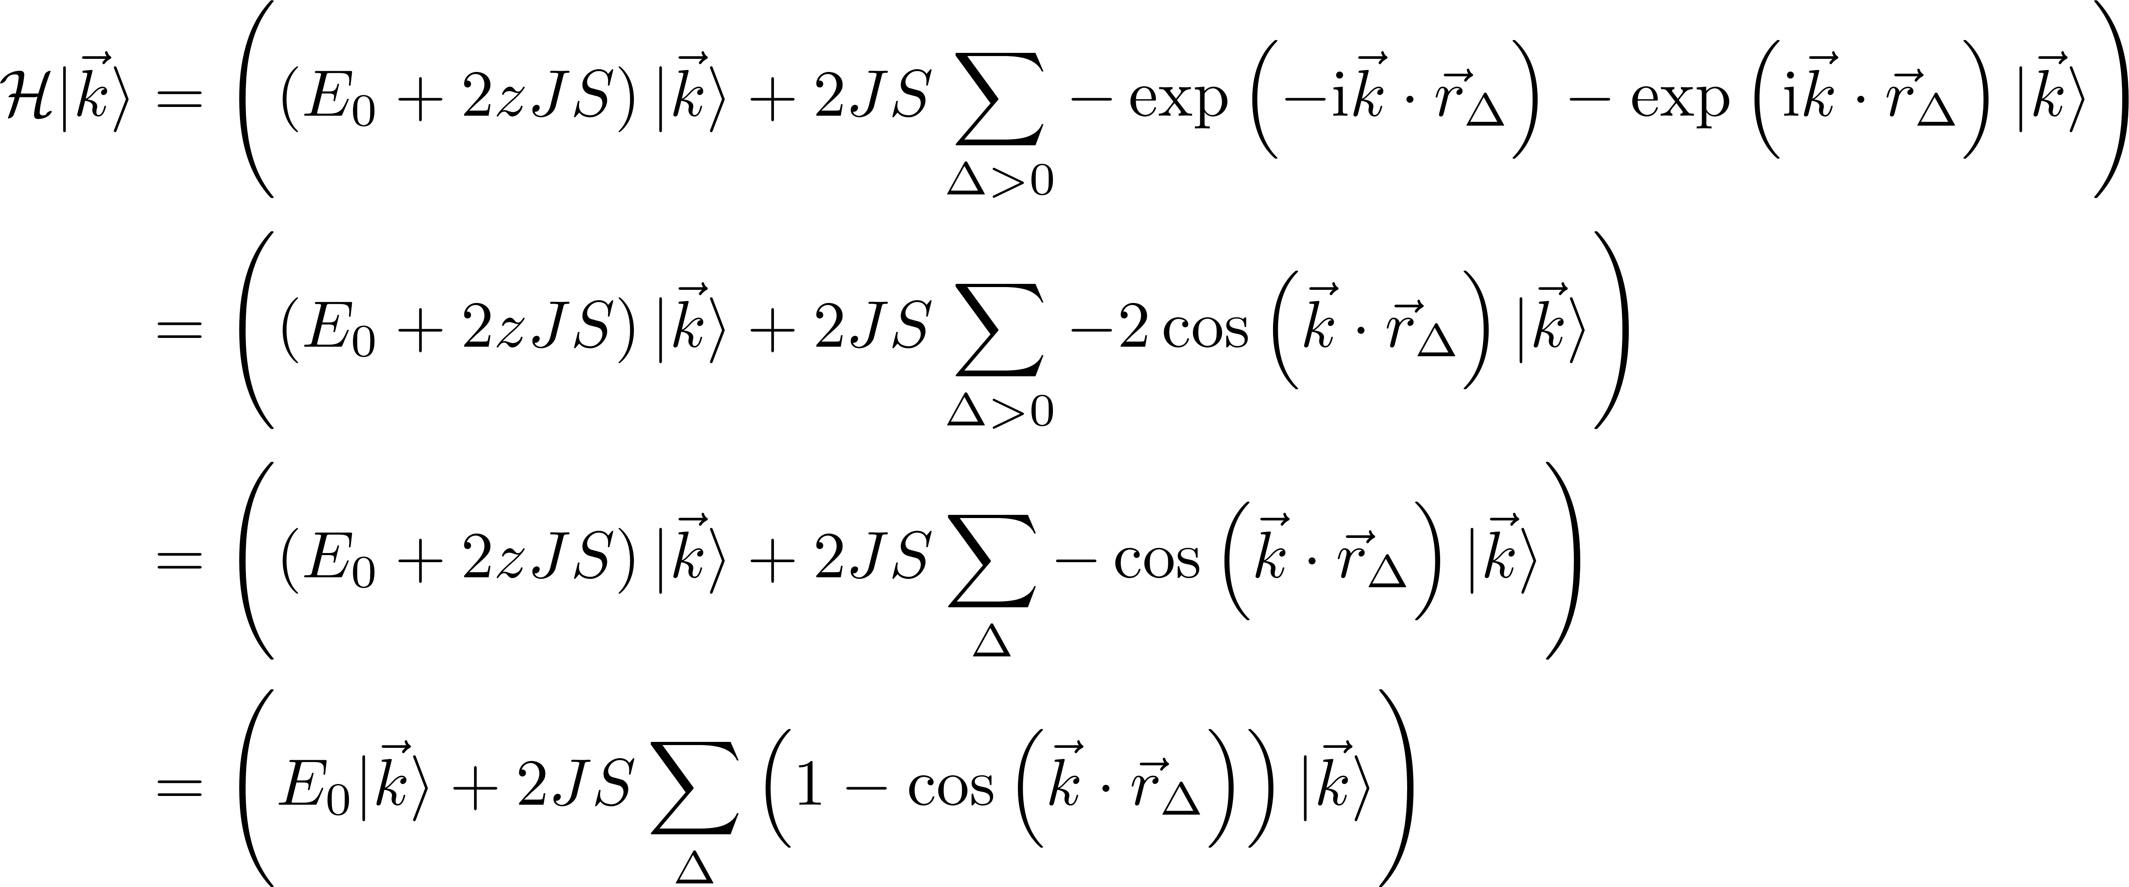
Ferromagnetic Dispersion relation
Properties of the eigenstates
Notes:
The z hides under the sum, because the sum over delta runs over all interactions hence sum 1 = z
The sum for the linear chain of spins

Slide 18
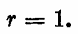
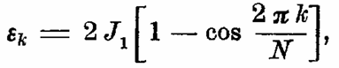
Ferromagnetic Dispersion relation
Properties of the eigenstates
Same result with semiclassical
calculation
F.Bloch. Z.Physik 61, 206-219 (1930)
Notes:
The z hides under the sum, because the sum over delta runs over all interactions hence sum 1 = z
The sum for the linear chain of spins

Slide 19
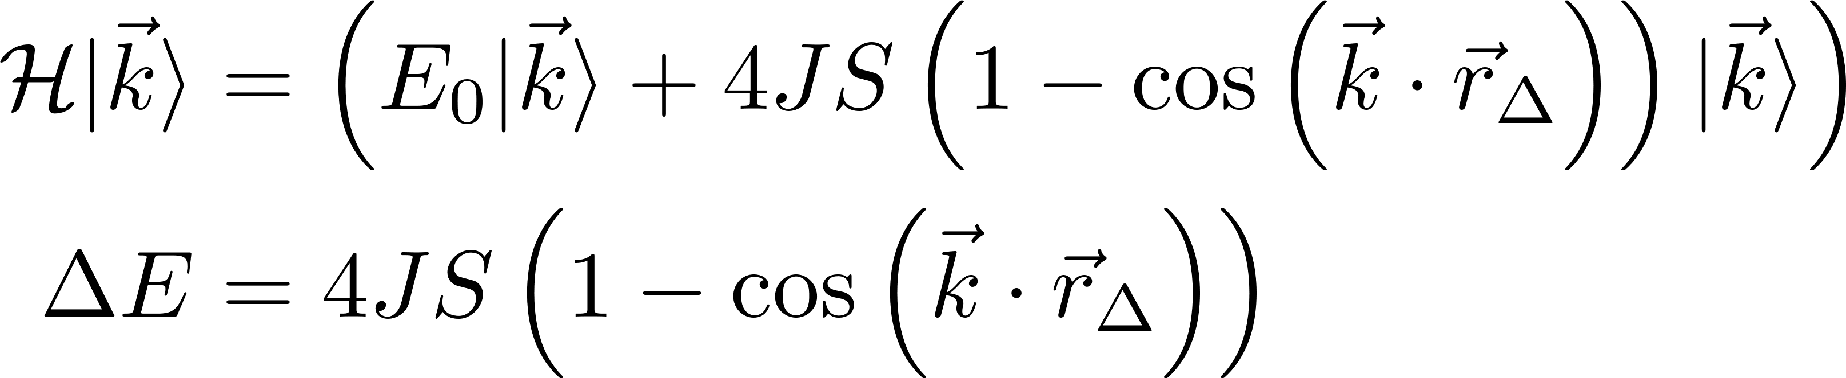
Ferromagnetic Dispersion relation
Properties of the eigenstates
Same result with semiclassical
calculation
F.Bloch. Z.Physik 61, 206-219 (1930)
For a linear chain with NN
S.Blundell, Magnetism in Condensed matter (2000)
Notes:
The z hides under the sum, because the sum over delta runs over all interactions hence sum 1 = z
The sum for the linear chain of spins

Slide 20
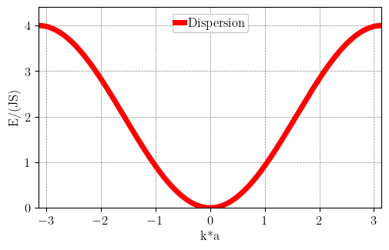
Ferromagnetic Dispersion relation
Properties of the eigenstates
F.Bloch. Z.Physik 61, 206-219 (1930)

Slide 21
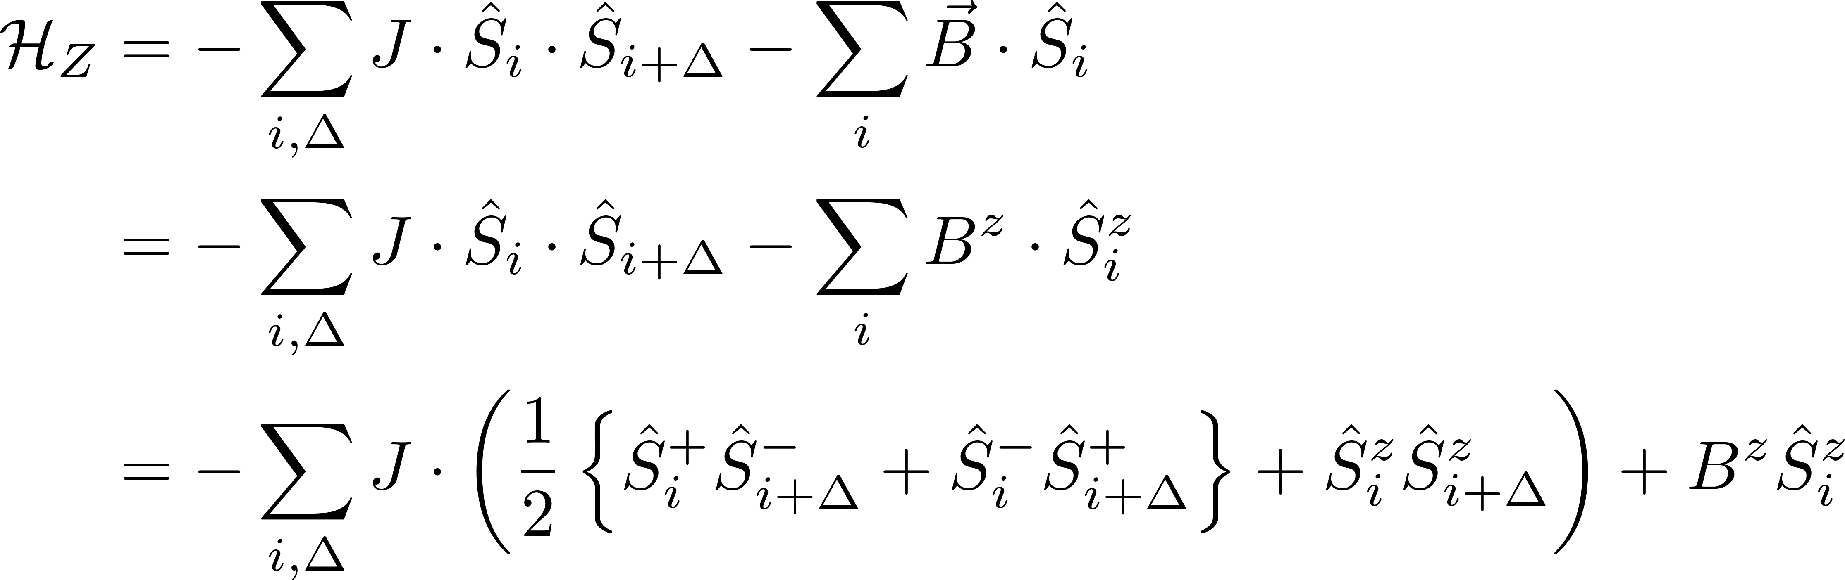
Ferromagnetic Dispersion relation with a magnetic Field
Addition of Zeeman term
Notes:
Since we have no anisotropy or anything else that breaks the isotropic hamilotoain we can always chose the field to be along the quantisation axis
Anisotropy term would like (write on blackboard maybe)

Slide 22
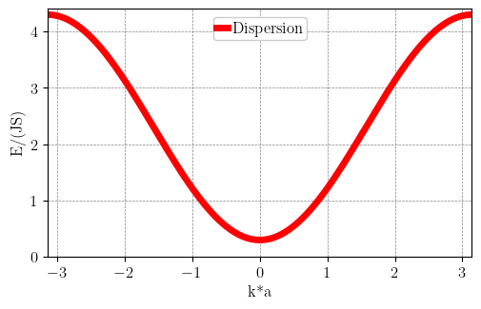
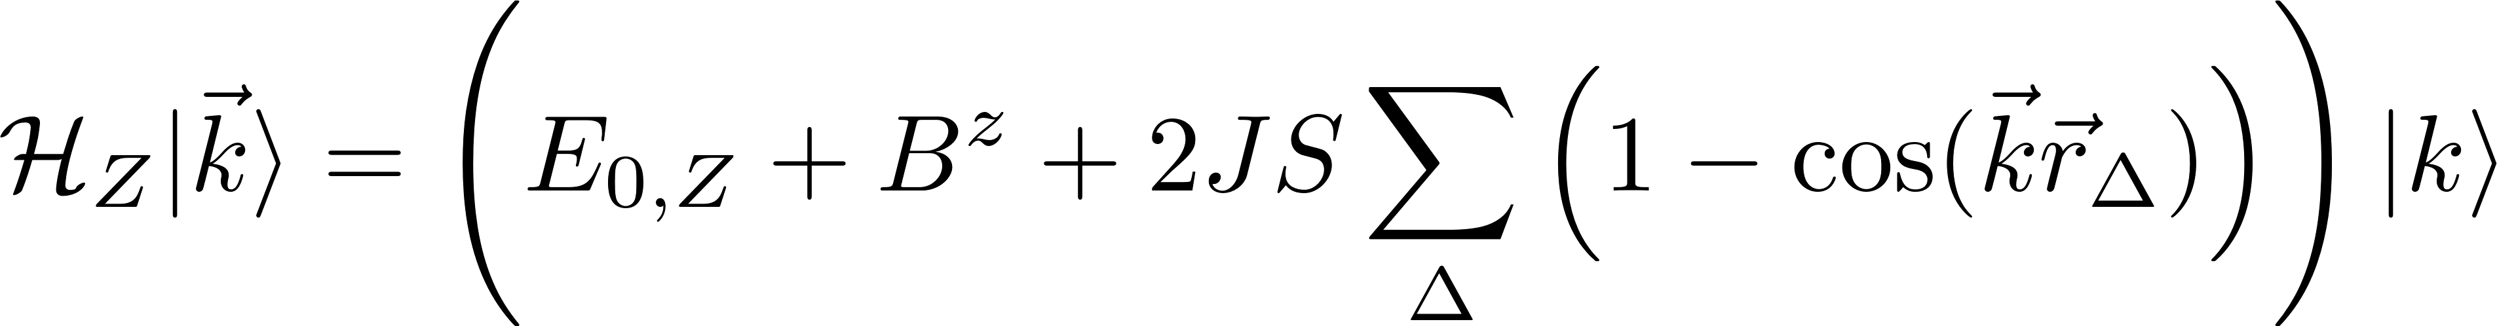
Ferromagnetic Dispersion relation with a magnetic Field
Addition of Zeeman term
Notes:
Since we have no anisotropy or anything else that breaks the isotropic hamilotoain we can always chose the field to be along the quantisation axis
Anisotropy term would like (write on blackboard maybe)

Slide 23
Recap
First excited state
Delocalization of a “flipped” spin over all sites
Notes:
Delocalization of a “flipped” spin over all sites
Collective excitation of the system
The probability to find the excitation at any site m is 1/N
And how do we name such a magnetic boson ? We combine the names to magnon

Slide 24
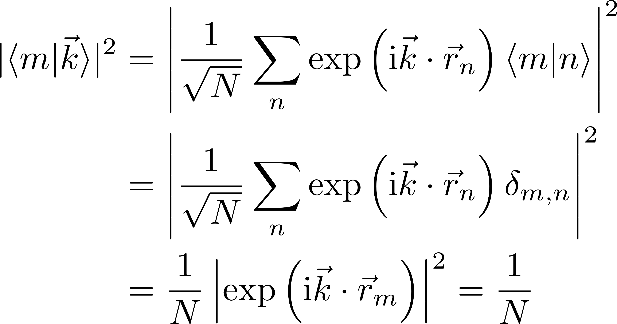
Recap
First excited state
Delocalization of a “flipped” spin over all sites
Collective excitation
Notes:
Delocalization of a “flipped” spin over all sites
Collective excitation of the system
The probability to find the excitation at any site m is 1/N
And how do we name such a magnetic boson ? We combine the names to magnon

Slide 25
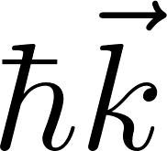
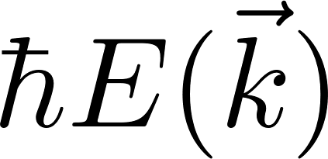
Recap
First excited state
Delocalization of a “flipped” spin over all sites
Collective excitation
By comparison to phonons:
-Well defined momentum
-Energy
Quasiparticle
Notes:
Delocalization of a “flipped” spin over all sites
Collective excitation of the system
The probability to find the excitation at any site m is 1/N
And how do we name such a magnetic boson ? We combine the names to magnon

Slide 26
Recap
First excited state
Delocalization of a “flipped” spin over all sites
Collective excitation
By comparison to phonons:
-Well defined momentum
-Energy
Reduces magnetization by 1 Integer spin Boson
Quasiparticle
Notes:
Delocalization of a “flipped” spin over all sites
Collective excitation of the system
The probability to find the excitation at any site m is 1/N
And how do we name such a magnetic boson ? We combine the names to magnon

Slide 27
Recap
First excited state
Delocalization of a “flipped” spin over all sites
Collective excitation
By comparison to phonons:
-Well defined momentum
-Energy
Reduces magnetization by 1 Integer spin Boson
Quasiparticle
Magnon
Notes:
Delocalization of a “flipped” spin over all sites
Collective excitation of the system
The probability to find the excitation at any site m is 1/N
And how do we name such a magnetic boson ? We combine the names to magnon

Slide 28
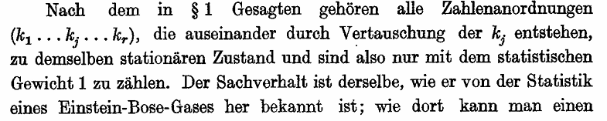
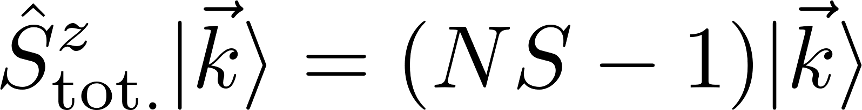
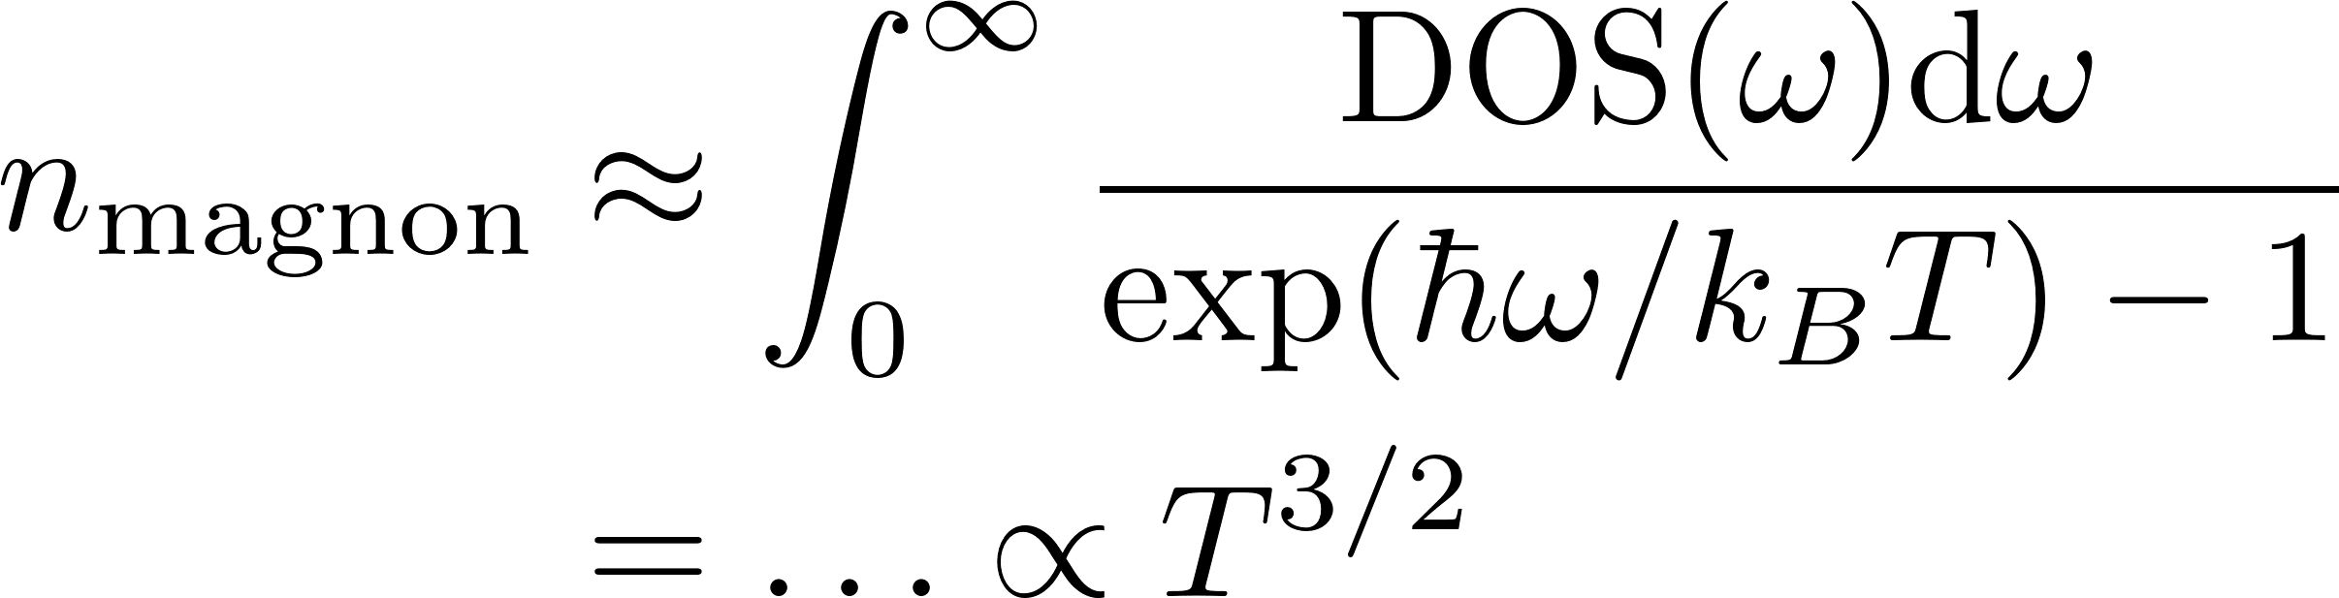
Magnons as Bosons
Thermodynamical treatment
Since it is a boson it must fulfill Bose-Einstein-statistic
F.Bloch. Z.Physik 61, 206-219 (1930)
Bose factor
Number of magnons @ T
Notes:
The more magnons we have the more the magnetsiatioin is reduced
The density of states can be estimated from the dispersion relation
This has been reproduces by many experiments
Fun fact for an isotropic Heisenberg ferromagnet in 1 or 2 d the intergral diverges for all T>0, hence infinite number of magnons, hence sponatanoues ferromagnetism is not possible (Mermin-Wagner-Berezinnskii-theorem) does work with non

Slide 29
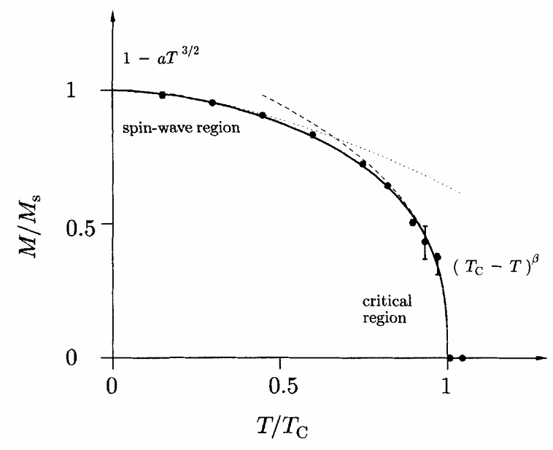
Magnons as Bosons
Thermodynamical treatment
Since it is a boson it must fulfill Bose-Einstein-statistic
F.Bloch. Z.Physik 61, 206-219 (1930)
Bose factor
Number of magnons @ T
S.Blundell, Magnetism in Condensed matter (2000)
Notes:
The more magnons we have the more the magnetsiatioin is reduced
The density of states can be estimated from the dispersion relation
This has been reproduces by many experiments
Fun fact for an isotropic Heisenberg ferromagnet in 1 or 2 d the intergral diverges for all T>0, hence infinite number of magnons, hence sponatanoues ferromagnetism is not possible (Mermin-Wagner-Berezinnskii-theorem) does work with non

Slide 30
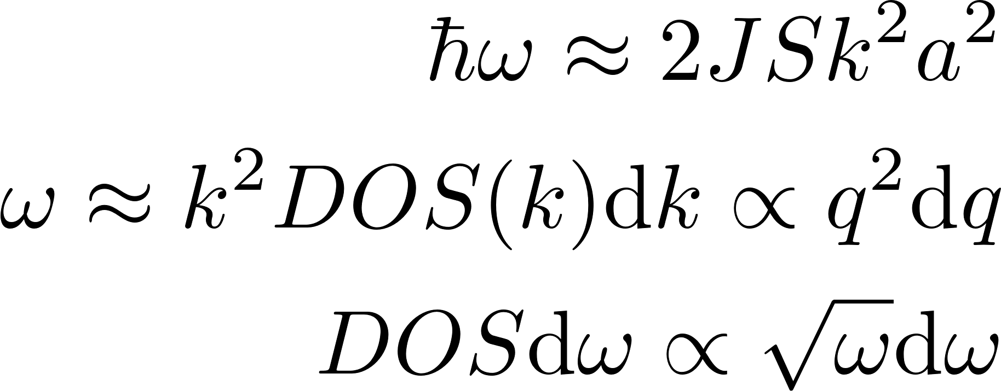
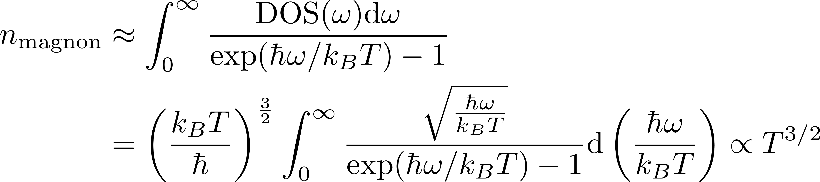
Magnons as Bosons
Thermodynamical treatment
Since it is a boson it must fulfill Bose-Einstein-statistic
Each thermally excited magnon reduces the magnetization by 1
F.Bloch. Z.Physik 61, 206-219 (1930)
Bose factor
Number of magnons @ T
S.Blundell, Magnetism in Condensed matter (2000)
Notes:
The more magnons we have the more the magnetsiatioin is reduced
The density of states can be estimated from the dispersion relation
This has been reproduces by many experiments
Fun fact for an isotropic Heisenberg ferromagnet in 1 or 2 d the intergral diverges for all T>0, hence infinite number of magnons, hence sponatanoues ferromagnetism is not possible (Mermin-Wagner-Berezinnskii-theorem) does work with non

Slide 31
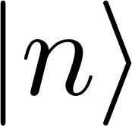
Spin-Boson Transformation
How to describe Magnons
The spin operators are not bosonic
Magnons are bosonic
Alternative approach:
LLG (analytically or numerically)
Or Schwinger representation
Or Dyson–Maleev representation
Conditions
The transformation needs to be Hermitian, raising and lowering operators written as creation and annihilation boson operators need to be Hermitian conjugate of each other
The transformation must be unitary to preserve the commutation relations between the spin operators.
Must satisfy the equality between the matrix elements of the spin operators on |0> and the bosons on |n>
E.Rastelli, Statistical Mechanics of Magnetic Excitations (2013)
Notes:
Search transformation that writes the ang. Moment. Operators as bosonic creation and annihilation operators
Or Dyson–Maleev representation breaks (i)

Slide 32
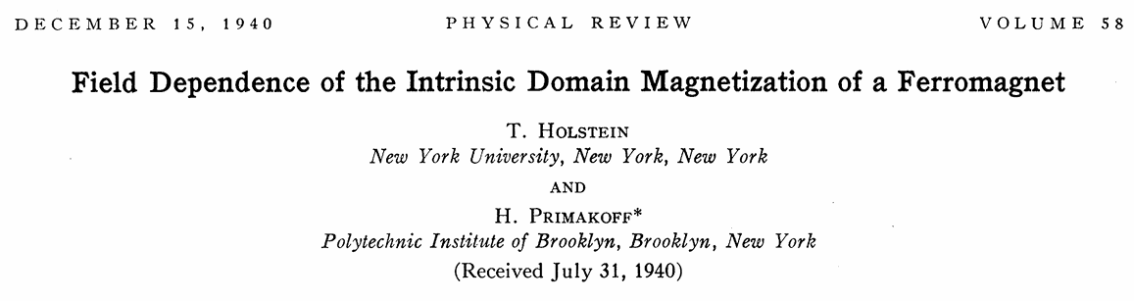
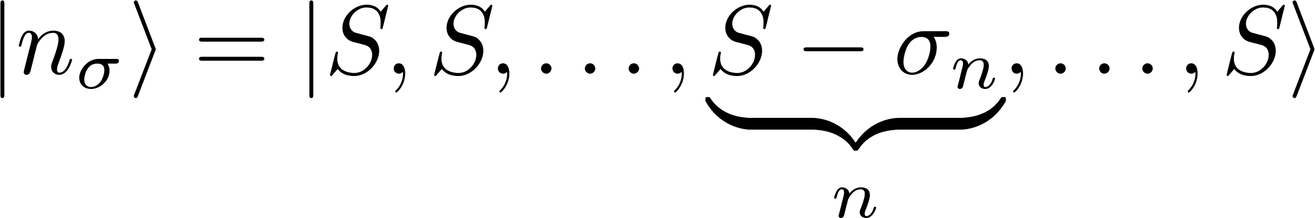
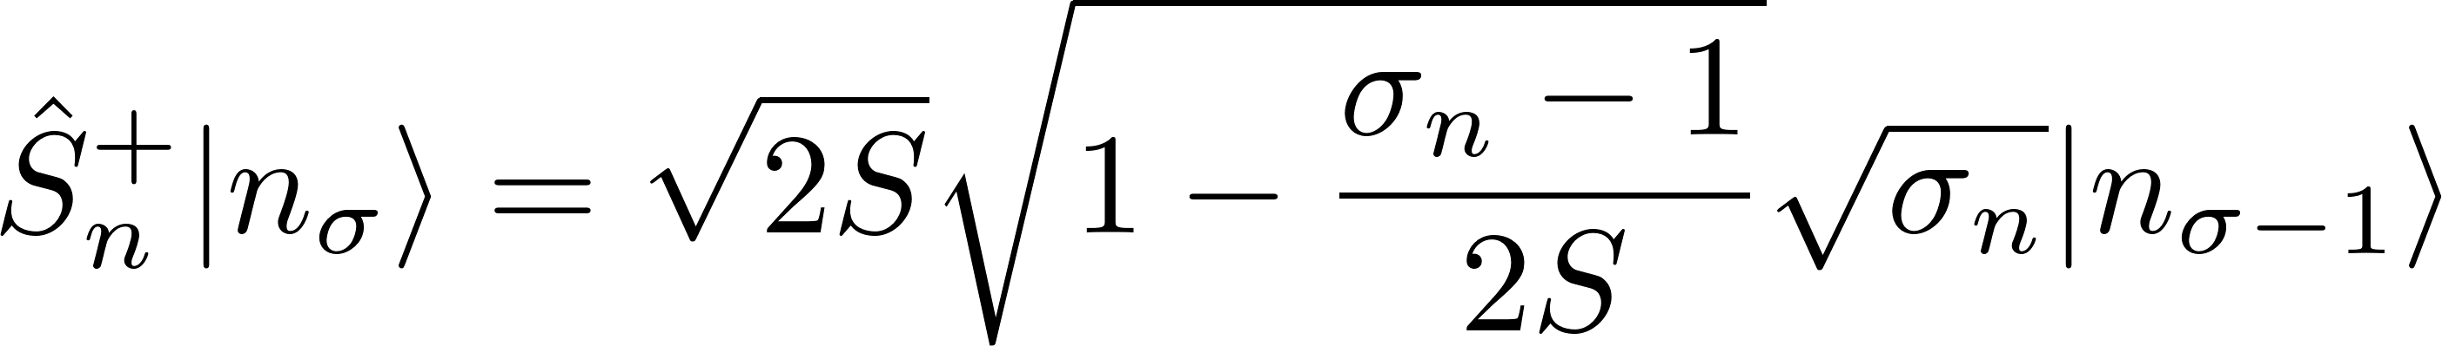
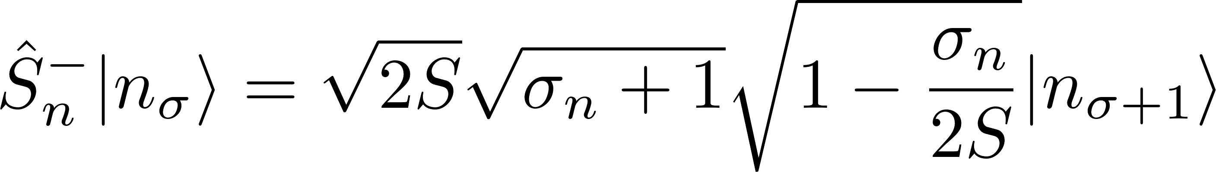
A Spin-Boson Transformation
Define higher magnon states
Notes:
We do not use the k state yet, since if they are equal here we can later use the determination of the k state (same as before) and they should still be identical (thats how they do it in thier paper

Slide 33
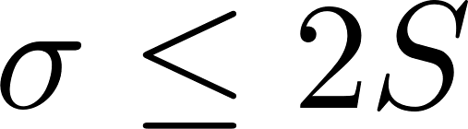
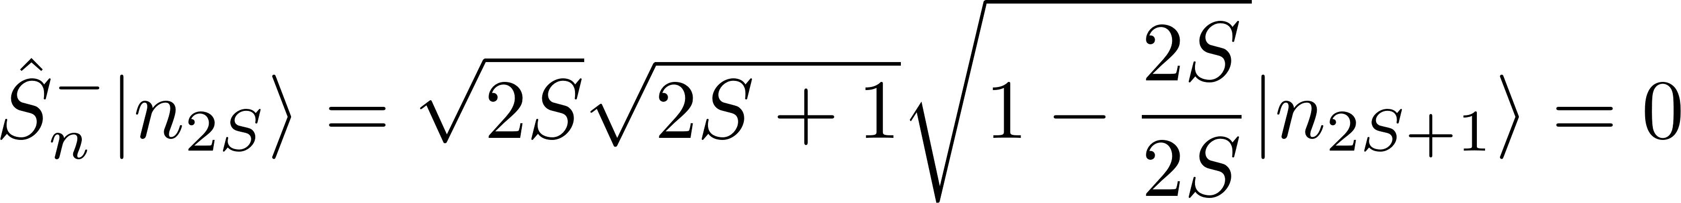
A Spin-Boson Transformation
Define higher magnon states
Only for

Slide 34
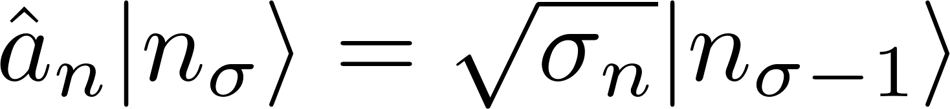
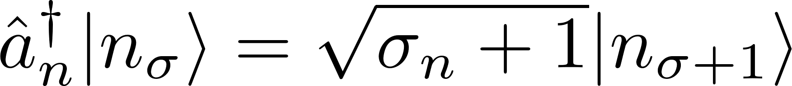
A Spin-Boson Transformation
Consider the states to be like 2nd quantized number states
Compare the “eigenvalues”
Only for

Slide 35



A Spin-Boson Transformation
Consider the states to be like 2nd quantized number states
Compare the “eigenvalues”
x

Slide 36


The Holstein Primakoff Spin-Boson Transformation
Combined
T-Holstein, H.Primakoff PR 58, 1098, (1940)
A magnon reduces the z-comp of the magnetization

Slide 37

T-Holstein, H.Primakoff PR 58, 1098, (1940)

Slide 38

The Holstein Primakoff Spin-Boson Transformation
Checking the conditions
Fulfilled
Does fulfill the Boson commutation relations
Fulfilled by definition
for
E.Rastelli, Statistical Mechanics of Magnetic Excitations (2013)

Slide 39

Holstein-Primakoff(HP)

Slide 40

Holstein-Primakoff(HP)
Applications
HP framework is a powerful method for calculating dispersions and higher order interactions
T-Holstein, H.Primakoff PR 58, 1098, (1940)
Notes:
This condtion that we need is in order to not have complex operaors

Slide 41




Linearized Holstein-Primakoff
Sacrifices
Does not fulfill the boson commutation relations
Hence (ii) is violated
T-Holstein, H.Primakoff PR 58, 1098, (1940)
Linearized HP
Notes:
This one breaks condition ii, which was that the commutation relations cant be broken

Slide 42

Holstein-Primakoff
Simplified application
Only linear Spin-Wave theory using the linearized HP
T-Holstein, H.Primakoff PR 58, 1098, (1940)
Linearized HP
Notes:
Want to express the Hamiltonian with the bosonic operators

Slide 43

Holstein-Primakoff
Linearized HP
Rewrite the Hamiltonian
Time evolution of an operator :
Notes:
What can we do with this expression?
We can look at the time evolution of an operator

Slide 44

Holstein-Primakoff
Linearized HP
Rewrite the Hamiltonian
Time evolution of an operator :
Problem: coupling between all sites! Practically unsolvable for real systems
Notes:
What can we do with this expression?
We can look at the time evolution of an operator

Slide 45


Holstein-Primakoff
The new Hamiltonian
Time evolution of an operator :
Going to Fourier-space
Lattice Fourier transformation
Problem: coupling between all sites! Practically unsolvable for real systems

Slide 46

Holstein-Primakoff
The new Hamiltonian
Time evolution of an operator :
Going to Fourier-space
Lattice Fourier transformation
Time evolution
Problem: coupling between all sites! practically unsolvable for real systems

Slide 47

Holstein-Primakoff
The new Hamiltonian
Time evolution of an operator :
Going to Fourier-space
Lattice Fourier transformation
Time evolution
Plug in
Problem: coupling between all sites! practically unsolvable for real systems

Slide 48


Holstein-Primakoff
Using translational invariance
L. Rósza, Lecture Notes (2022)

Slide 49





Holstein-Primakoff
Solving the differential equation
With the spin-wave frequency
L. Rósza, Lecture Notes (2022)
Notes:
Let us now consider a single frequency spin wave, represented by

Slide 50

Holstein-Primakoff
Solving the differential equation
With the spin-wave frequency
L. Rósza, Lecture Notes (2022)
Notes:
Let us now consider a single frequency spin wave k_0, hence the sum over k will vanish
If one would expand on the omega_k one would obtain the same spin wave dispersion as before

Slide 51


Holstein-Primakoff
Solving the differential equation
With the spin-wave frequency
L. Rósza, Lecture Notes (2022)
Notes:
Let us now consider a single frequency spin wave k_0, hence the sum over k will vanish
If one would expand on the omega_k one would obtain the same spin wave dispersion as before

Slide 52

Holstein-Primakoff Dispersion relation
Notes:
The z hides under the sum, because the sum over delta runs over all interactions hence sum 1 = z
The sum for the linear chain of spins

Slide 53


Holstein-Primakoff
Linearized HP
Back to Real-space

Slide 54


Holstein-Primakoff
Linearized HP
Back to Real-space
S.Blundell, Magnetism in Condensed matter (2000)
This explains why the average we calculated earlier was 0

Slide 55



Holstein-Primakoff & Bogolibuv transformation
Considering more interactions
Adding on site anisotropy
Let's simplify this
Wrong!!!!
This slide is still work in progress
Notes:
The difference is know that we have magnon NON conservive terms

Slide 56


Holstein-Primakoff & Bogoliubov transformation
In-plane anisotropy
Considering more interactions
Notes:
The difference is know that we have magnon NON conservive terms

Slide 57


Holstein-Primakoff & Bogoliubov transformation
In-plane anisotropy
Considering more interactions
Linearized HP
Notes:
The difference is know that we have magnon NON conservive terms

Slide 58

Holstein-Primakoff & Bogoliubov transformation
In-plane anisotropy
Considering more interactions
Linearized HP
How to diagonalize this ?
Notes:
The difference is know that we have magnon NON conservive terms

Slide 59

Holstein-Primakoff & Bogoliubov transformation
How to diagonalize this
Notes:
The difference is know that we have magnon NON conservive terms

Slide 60



Holstein-Primakoff & Bogoliubov transformation
How to diagonalize this
Seek a Bogoliubov transformation
That diagonalizes to
Notes:
The difference is know that we have magnon NON conservive terms

Slide 61
Holstein-Primakoff & Bogoliubov transformation
How to diagonalize this
Seek a Bogoliubov transformation
That diagonalizes to
Notes:
The difference is know that we have magnon NON conservive terms

Slide 62

Holstein-Primakoff & Bogoliubov transformation
How to diagonalize this
Diagonalize with
Notes:
However this does not work. The problem is that in addition to diagonalizing the H matrix we also have to preserve the commutation relations.
We will see that the actual energies of the system are not obtained from the the eigenvalues of H

Slide 63




Holstein-Primakoff & Bogoliubov transformation
How to diagonalize this
Diagonalize with
Since we need to preserve the commutation relations:
Or equivalently
Thus it needs to be a pseudounitary transformation
Notes:
However this does not work. The problem is that in addition to diagonalizing the H matrix we also have to preserve the commutation relations.
We will see that the actual energies of the system are not obtained from the the eigenvalues of H

Slide 64

Holstein-Primakoff & Bogoliubov transformation
How to diagonalize this
Need to preserve the commutation relations:
Or equivalently
Notes:
However this does not work. The problem is that in addition to diagonalizing the H matrix we also have to preserve the commutation relations.
We will see that the actual energies of the system are not obtained from the the eigenvalues of H

Slide 65



Holstein-Primakoff & Bogoliubov transformation
How to diagonalize this
What we need to solve
Such that
Notes:
However this does not work. The problem is that in addition to diagonalizing the H matrix we also have to preserve the commutation relations.
We will see that the actual energies of the system are not obtained from the the eigenvalues of H

Slide 66




Holstein-Primakoff & Bogoliubov transformation
How to diagonalize this
Solve this:
With this we need a new set of operators
B.Latz Thesis, Heidelberg, (2009)
Notes:
The difference is know that we have magnon NON conservive terms

Slide 67


Holstein-Primakoff & Bogoliubov transformation
How to diagonalize this
They still fulfill bosonic commutation relations
Notes:
The difference is know that we have magnon NON conservive terms

Slide 68



Holstein-Primakoff & Bogoliubov transformation
How to diagonalize this
They still fulfill bosonic commutation relations
Notes:
This matrix is hermitian and in general it would have the bottom K complex conjugated, but in this simple example it is real

Slide 69


Holstein-Primakoff & Bogoliubov transformation
How to diagonalize this
Notes:
This matrix is hermitian and in general it would have the bottom K complex conjugated, but in this simple example it is real
To conclude, a diagonal Bogoliubov Hamiltonian can be obtained by a corresponding transformation of the state. Physically this implies that the problem becomes diagonal in the basis of quasi-particle modes, describing the characteristic and energetically low-lying excitations of the system. Therefore, computing observables of the transformed state becomes significantly easier

Slide 70

Holstein-Primakoff & Bogoliubov transformation
How to diagonalize this
Lattice Fourier transformation
Notes:
This matrix is hermitian and in general it would have the bottom K complex conjugated, but in this simple example it is real
To conclude, a diagonal Bogoliubov Hamiltonian can be obtained by a corresponding transformation of the state. Physically this implies that the problem becomes diagonal in the basis of quasi-particle modes, describing the characteristic and energetically low-lying excitations of the system. Therefore, computing observables of the transformed state becomes significantly easier

Slide 71



Holstein-Primakoff & Bogoliubov transformation
Considering more interactions
Adding DMI (CHECK IF ALREADY THERE, from other presentations
D. Wuhrer et.al. PR 5, 043124, (2023)
This slide is still work in progress
Notes:
The difference is know that we have magnon NON conservive terms

Slide 72


Holstein-Primakoff & Bogoliubov transformation
Bogoliubov transformation
D. Wuhrer et.al. PR 5, 043124, (2023)
This slide is still work in progress
Notes:
The difference is know that we have magnon NON conservive terms

Slide 73


Holstein-Primakoff & Bogoliubov transformation
Bogoliubov transformation
D. Wuhrer et.al. PR 5, 043124, (2023)
This slide is still work in progress
Notes:
The difference is know that we have magnon NON conservive terms

Slide 74


Visualising a Magnon
Numerical methods
Integrate using the Landau Lifshitz Gilbert equation.
Time integration with Heun’s methods
Additional property is the damping
Engine_LLG\Test.ipynb
Notes:
Based on the Lamor-frequency we can numerically integrate a system of spins using the Landau Lifshitz Gilbert equation.
Time integration done with Heun’s methods
With this method one could also determine the dispersion relation
Additional property is the damping

Slide 75


Visualising a Magnon
Numerical methods
Integrate using the Landau Lifshitz Gilbert equation.
Time integration with Heun’s methods
Additional property is the damping
Engine_LLG\Test.ipynb
Notes:
Based on the Lamor-frequency we can numerically integrate a system of spins using the Landau Lifshitz Gilbert equation.
Time integration done with Heun’s methods
Temperaruter would need to behave like Gaussian white noise
With this method one could also determine the dispersion relation
Additional property is the damping

Slide 76




Outlook
Current research
Easily obtain highly interesting dispersion relations.
Can be used for computing, without energy loss through Joule heating
This is ongoing research in
Spin wave diodes
Spin wave transitors
The most modern research even includes Altermagnets, which have distinct symmetry enforced properties regarding the dispersion in different directions
Topological magnons
Squeezed magnons
D. Wuhrer et.al. PR 5, 043124, (2023)
J.Lan et.al. PRX 5, 041049, (2015)
A.Chumak et.al. Nature C. 5, 4700, (2014)
J.Lan et.al. PRX 5, 041049, (2015)
P. McClarty Annual Reviews 13, 171-190, (2022)
D. Wuhrer et.al. PR 5, 043124, (2023)
A.Chumak et.al. Nature C. 5, 4700, (2014)

Slide 77
Weiss-Model eines Ferromagneten
Kritik
Selbst bei seiner Veröffentlichung bemängelt er die unphysikalische Größe des Feldes
„Das Feld [der Atome] ist jedoch mehr als tausendmal schwächer als das Molekularfeld […]. Diese Interpretationsschwierigkeit [soll] weniger als Einwand denn als Hinweis für die Suche nach neuen Hypothesen über den Aufbau des Atoms angesehen werden […].“
Model war dennoch auf den Prinzipien der statistischen Physik begründet und „formal befriedigend“.(Heisenberg)
Model war erfolgreich, nur die großen Felder sorgten für Unmut.
Heisenbergs Lösung
Etwa 30 Jahre später konnte Heisenberg die Probleme mit Hilfe der Austauschwechselwirkung lösen
Diese wollen wir nun in Teilen herleiten

Slide 78





Heisenbergs Theorie des Ferromagnetismus
Heisenbergs Lösung
Etwa 30 Jahre später konnte Heisenberg die Probleme mit Hilfe der Austauschwechselwirkung lösen
Diese wollen wir nun in Teilen herleiten
Betrachten wir zwei Elektronen (eines Atoms)
Wir definieren qi = ri,si mit

Slide 79
Heisenbergs Theorie des Ferromagnetismus
Heisenbergs Lösung
Etwa 20 Jahre später konnte Heisenberg die Probleme mit Hilfe der Austauschwechselwirkung lösen
Diese wollen wir nun in Teilen herleiten
Betrachten wir zwei Elektronen (eines Atoms)

Slide 80

Heisenbergs Theorie des Ferromagnetismus
Heisenbergs Lösung
Aufteilen der Wellenfunktion in einen Orts-teil und einen Spin-teil
Psi (q_1,q_2) = Phi (r_1,r_2) * xi (s_1,s
Dies ist noch kein physikalischer Zustand
Muss noch symmetrisiert werden
Elektronen => Antisymmetrisierung

Slide 81









Heisenbergs Theorie des Ferromagnetismus
Heisenbergs Lösung
Aufteilen der Wellenfunktion in einen Orts-teil und einen Spin-teil
Psi(q_1,q_2) = psi_1(q_1) * psi_2(q_2)
Dies ist noch kein physikalischer Zustand
Muss noch symmetrisiert werden
Elektronen => Antisymmetrisierung
Daraus folgen zwei Fälle
Phi (r_1,r_2) =
r
S_{z}
S²
S₁S₂
1
1
$$\frac{1}{4}$$
Triplett
(sym.)
0
1
$$\frac{1}{4}$$
-1
1
$$\frac{1}{4}$$
Singlett
(asym.)
0
0
$$−\frac{3}{4}$$
Notes:
Warum net |11> und |10>, weil man gerne eine Basis hat die den Gesamtspin und S^2 und S_z diagonalisiert und |10> ist kein EZ von S^2 ist

Slide 82





Heisenbergs Theorie des Ferromagnetismus
Heisenbergs Lösung
Aufteilen der Wellenfunktion in einen Orts-teil und einen Spin-teil
Psi(q_1,q_2) = psi_1(q_1) * psi_2(q_2)
Dies ist noch kein physikalischer Zustand
Muss noch symmetrisiert werden
Elektronen => Antisymmetrisierung
Daraus folgen zwei Fälle
Phi (r_1,r_2) =
r
S_{z}
S²
S₁S₂
1
1
$$\frac{1}{4}$$
Triplett
(sym.)
0
1
$$\frac{1}{4}$$
-1
1
$$\frac{1}{4}$$
Singlett
(asym.)
0
0
$$−\frac{3}{4}$$
Notes:
Warum net |11> und |10>, weil man gerne eine Basis hat die den Gesamtspin und S^2 und S_z diagonalisiert und |10> ist kein EZ von S^2 ist

Slide 83




Heisenbergs Theorie des Ferromagnetismus
Heisenbergs Lösung
Hamiltonian
t
2 „nur“ eine Coulomb Wechselwirkung
Gesamtenergie
T
r
S_{z}
S²
S₁S₂
1
1
$$\frac{1}{4}$$
Triplett
(sym.)
0
1
$$\frac{1}{4}$$
-1
1
$$\frac{1}{4}$$
Singlett
(asym.)
0
0
$$−\frac{3}{4}$$
Notes:
Warum net |11> und |10>, weil man gerne eine Basis hat die den Gesamtspin und S^2 und S_z diagonalisiert und |10> ist kein EZ von S^2 ist

Slide 84





Heisenbergs Theorie des Ferromagnetismus
Heisenbergs Lösung
Hamiltonian
t
2 „nur“ eine Coulomb Wechselwirkung
Gesamtenergie
T
r
S_{z}
S²
S₁S₂
1
1
$$\frac{1}{4}$$
Triplett
(sym.)
0
1
$$\frac{1}{4}$$
-1
1
$$\frac{1}{4}$$
Singlett
(asym.)
0
0
$$−\frac{3}{4}$$
S.Chikazumi Physics of Ferromagnetism (2009)

Slide 85
Heisenbergs Theorie des Ferromagnetismus
Heisenbergs Lösung
Ergebnis und Interpretation
t
Gibt eine Energiedifferenz zwischen dem Singlett und dem Triplett Zustand basierend auf der Coulombenergie und der asymmetrischen Wellenfunktion.
Abhängig vom Überlapp der Wellenfunktionen
Eisen/Nickel-Salz Lösungen sind nicht ferromagnetisch
Je nach Situation ist entweder der Triplett oder der Singlett Zustand energetisch günstiger
S_{z}
S²
S₁S₂
1
1
$$\frac{1}{4}$$
Triplett
(sym.)
0
1
$$\frac{1}{4}$$
-1
1
$$\frac{1}{4}$$
W.Heisenberg Z.Physik 49, 619-636, (1928)
Singlett
(asym.)
0
0
$$−\frac{3}{4}$$

Slide 86




Heisenbergs Theorie des Ferromagnetismus
Heisenbergs Lösung
Ergebnis und Interpretation
tt
Konstruktion eines „effektiven Hamiltonian“:
Zur Unterscheidung von T u. S geht sowohl S² und S₁S₂
S_{z}
S²
S₁S₂
1
1
$$\frac{1}{4}$$
Triplett
(sym.)
0
1
$$\frac{1}{4}$$
-1
1
$$\frac{1}{4}$$
Singlett
(asym.)
0
0
$$−\frac{3}{4}$$

Slide 87


Heisenbergs Theorie des Ferromagnetismus
Heisenbergs Lösung
Ergebnis und Interpretation
tt
Konstruktion eines „effektiven Hamiltonian“:
Zur Unterscheidung von T u. S geht sowohl S² und S₁S₂
4
5
6
S_{z}
S²
S₁S₂
1
1
$$\frac{1}{4}$$
Triplett
(sym.)
0
1
$$\frac{1}{4}$$
-1
1
$$\frac{1}{4}$$
Singlett
(asym.)
0
0
$$−\frac{3}{4}$$

Slide 88

Heisenbergs Theorie des Ferromagnetismus
Heisenbergs Lösung
Ergebnis und Interpretation
ttt
Konstruktion eines „effektiven Hamiltonian“:
4
S_{z}
S²
S₁S₂
1
1
$$\frac{1}{4}$$
Triplett
(sym.)
0
1
$$\frac{1}{4}$$
-1
1
$$\frac{1}{4}$$
Singlett
(asym.)
0
0
$$−\frac{3}{4}$$

Slide 89

Heisenbergs Theorie des Ferromagnetismus
Heisenbergs Lösung
Ergebnis und Interpretation
tt
Konstruktion eines „effektiven Hamiltonian“:
4
S_{z}
S²
S₁S₂
1
1
$$\frac{1}{4}$$
Triplett
(sym.)
0
1
$$\frac{1}{4}$$
-1
1
$$\frac{1}{4}$$
Singlett
(asym.)
0
0
$$−\frac{3}{4}$$

Slide 90


Heisenbergs Theorie des Ferromagnetismus
Heisenbergs Lösung
Ergebnis und Interpretation
tt
Konstruktion eines „effektiven Hamiltonian“:
4
Obacht mit dem Vorzeichen und der 2
Semiklassische Näherung
Ttt
t
S_{z}
S²
S₁S₂
1
1
$$\frac{1}{4}$$
Triplett
(sym.)
0
1
$$\frac{1}{4}$$
-1
1
$$\frac{1}{4}$$
Singlett
(asym.)
0
0
$$−\frac{3}{4}$$

Slide 91






Heisenbergs Theorie des Ferromagnetismus
Heisenbergs Erweiterung
Er
„Beweis durch Simulation“
Erfolge
Luis Neél verwendete das Heisenberg Modell zur Entdeckung/Beschreibung von Antiferro-und Ferrimagnetismus.
Simulationen/Berechnungen von Magnonen/Dispersionen
Aktuelle Forschung zu (gequetschten) Magnonen
Forschungsgebiet der Spintronik
Nicht nur direkte Wechselwirkung
S_{z}
S²
S₁S₂
W.Heisenberg Z.Physik 49, 619-636, (1928)
1
1
$$\frac{1}{4}$$
L. Néel An. de phys. 12, 137-198 (1948)
0
1
$$\frac{1}{4}$$
Triplett
(sym.)
-1
1
$$\frac{1}{4}$$
Singlett
(asym.)
0
0
$$−\frac{3}{4}$$

Slide 92





Weitere Arten von magnetischer Ordnung
Ferrimagnete (1930er)
Antiferromagnete mit unterschiedlicher Magnetisierung für verschiedene Untergitter
Helimagnetismus (1959)
Spin Glässer(1973)
Zufälliges aber kooperatives Einfrieren von Spins
Frustrierter Magnetismus (1950-77)
Kollinear und Nicht-kollinear
Wikipedia.com
L. Néel An. de phys. 12, 137-198 (1948)
N.Jiang et al. Nature 11,1601 (2020)
A. Yoshimori J. Phys. Soc. Jpn. 14, 807-821 (1959)
Obacht
Pfeildarstellung der Spins ist semi-klassisch. Stets beachten dass es sich um quantenmechansiche Magnetisierungsdichten handelt.
D.Sherrington et al. PRL 35,26 (1975)
Wikipedia.com
G. Toulouse, Commun. Phys. 2, 115 (1977).
Fkf.mpg.de

Slide 93







NEWSFLASH
20.02.24
28.02.24
22.02.24

Slide 94
Woher kommt die Aufruhr?
Hall Effekt mit B-Feld
Mit B-Feld bereits bekannt
B
U_{Hall}
0
I
I
Notes:
Symmetrien sind in der Welt der Magnete sehr wichtig da sehr viele eigenschaften und Phänomene durch Symmetrien erklärt werden können

Slide 95
Woher kommt die Aufruhr?
Hall Effekt mit B-Feld
Mit B-Feld bereits bekannt
U_{Hall}
0
I
I
Notes:
Symmetrien sind in der Welt der Magnete sehr wichtig da sehr viele eigenschaften und Phänomene durch Symmetrien erklärt werden können

Slide 96

Woher kommt die Aufruhr?
Hall Effekt mit B-Feld
Mit B-Feld bereits bekannt
Anormaler Hall Effekt
Kein externes Feld B = 0
FM:
M
U_{Hall}
0
I
FM
I
Notes:
Symmetrien sind in der Welt der Magnete sehr wichtig da sehr viele eigenschaften und Phänomene durch Symmetrien erklärt werden können

Slide 97

Woher kommt die Aufruhr?
Hall Effekt mit B-Feld
Mit B-Feld bereits bekannt
Anormaler Hall Effekt
Kein externes Feld B = 0
FM:
AFM:
U_{Hall}
0
I
AFM
I
Notes:
Symmetrien sind in der Welt der Magnete sehr wichtig da sehr viele eigenschaften und Phänomene durch Symmetrien erklärt werden können

Slide 98

Woher kommt die Aufruhr?
Hall Effekt mit B-Feld
Mit B-Feld bereits bekannt
Anormaler Hall Effekt
Kein externes Feld B = 0
FM:
AFM:
??:
(in manchen Richtungen)
U_{Hall}
0
I
??
H. Reichlova et al. arXiv:2012.15651
I
Notes:
Symmetrien sind in der Welt der Magnete sehr wichtig da sehr viele eigenschaften und Phänomene durch Symmetrien erklärt werden können

Slide 99


Symmetrien
Zeitumkehroperator
Gegeben durch den Operator
Angewandt auf ein paar bekannte Größen
Notes:
Symmetrien sind in der Welt der Magnete sehr wichtig da sehr viele eigenschaften und Phänomene durch Symmetrien erklärt werden können

Slide 100
Symmetrien
Zeitumkehroperator
Gegeben durch den Operator
Angewandt auf ein paar bekannte Größen
Anschauung
Vorstellung von Ørsted (Uhlenbeck-Goudsmith)
e⁻ haben eine Ausdehnung
e⁻ rotieren um eigene Achse
Daraus folgt magnetisches Moment(Spin)
Zeitumkehr bedeutet nun dass die Rotationsrichtung umgekehrt wird
Folglich auch das magnetische Moment(Spin)
Notes:
Symmetrien sind in der Welt der Magnete sehr wichtig da sehr viele eigenschaften und Phänomene durch Symmetrien erklärt werden können

Slide 101

Symmetrien
Zeitumkehroperator
Gegeben durch den Operator
Angewandt auf ein paar bekannte Größen
Spin-Gruppen
Eine Symmetrie stellen wir da durch
Spin-Raum Gitter-Raum
Frage zur Klassifizierung: Kann eine Gittertransformation die Zeitumkehr aufheben?
L.Šmejkal et al. PRX 12, 031042 (2022)
L.Šmejkal et al. PRX 12, 031042 (2022)
Notes:
Symmetrien sind in der Welt der Magnete sehr wichtig da sehr viele eigenschaften und Phänomene durch Symmetrien erklärt werden können

Slide 102

Phasen des Magnetismus
Frage zur Klassifizierung: Kann eine Gittertransformation die Zeitumkehr aufheben?
Ferromagnetismus
Starke Magnetisierung

Slide 103

Phasen des Magnetismus
Frage zur Klassifizierung: Kann eine Gittertransformation die Zeitumkehr aufheben?
Ferromagnetismus: Nein
Starke Magnetisierung
Folge: Bandaufspaltung
Keine Zeitumkehrsymmetrie
L.Šmejkal et al. PRX 12, 040501 (2022)

Slide 104
Phasen des Magnetismus
Frage zur Klassifizierung: Kann eine Gittertransformation die Zeitumkehr aufheben?
Antiferromagnetismus
Keine Magnetisierung

Slide 105



Phasen des Magnetismus
Frage zur Klassifizierung: Kann eine Gittertransformation die Zeitumkehr aufheben?
Antiferromagnetismus:Ja
Keine Magnetisierung
Folge: Bandentartung
Symmetrien: Zeitumkehr + Translation
Zeitumkehr + Inversion
(Zeitumkehrsymmetrie)
L.Šmejkal et al. PRX 12, 040501 (2022)
Translation T
des Gitters

Slide 106
Phasen des Magnetismus
Frage zur Klassifizierung: Kann eine Gittertransformation die Zeitumkehr aufheben?
Altermagnetismus
Keine Magnetisierung

Slide 107


Phasen des Magnetismus
Frage zur Klassifizierung: Kann eine Gittertransformation die Zeitumkehr aufheben?
Altermagnetismus: Ja
Keine Magnetisierung
Folge: Bandaufspaltung?
Symmetrien: Zeitumkehr + Rotation
Keine Zeitumkehrsymmetrie
L.Šmejkal et al. PRX 12, 040501 (2022)
Rotation A
des Gitters

Slide 108
Phasen des Magnetismus
Frage zur Klassifizierung: Kann eine Gittersymmetrie die Zeitumkehr aufheben?
Antiferromagnetismus
Keine Magnetisierung

Slide 109
Phasen des Magnetismus
Ferromagnetismus
Starke Magnetisierung
Keine Zeitumkehrsymmetrie
Magnetisierung als Ordnungsparameter
Spin-polarisation im k-Raum
Isotrop
„Spin-splitting“ (magneto transport effects).
Elektronische Bandeffekte
Antiferromagnetismus
Keine effektive Magnetisierung
Kompensierende Ordnung
Zeitumkehrsymmetrie
Keine spin-polarisation im k-Raum

Slide 110
Phasen des Magnetismus
Ferromagnetismus
Starke Magnetisierung
Keine Time-reversal symmetry
Magnetisierung als Ordnungsparameter
Spin-polarisation im k-Raum
Isotrop
„Spin-splitting“ (magneto transport effects).
Elektronische Bandeffekte
Antiferromagnetismus
Keine effektive Magnetisierung
Kompensierende Ordnung
Time-reversal symmetry
Keine Spin-polarisation im k-Raum
Altermagnetismus
Keine effektive Magnetisierung
Keine Time-reversal symmetry
Spin-polarisation im k-Raum
„Spin-splitting“ (magneto transport effects).
Elektronische Bandeffekte
Zunächst als unkonventionelle AFM/FMs bezeichnet

Slide 111






Symmetrie Beschreibung der Phasen
Ferromagnetismus
Spin-Gruppe:
Antiferromagnetismus
Spin-Gruppe:
Altermagnetismus
Spin-Gruppe:
L.Šmejkal et al. PRX 12, 040501 (2022)
L.Šmejkal et al. PRX 12, 031042 (2022)

Slide 112
Symmetrie Beschreibung der Phasen
Ferromagnetismus
Spin-Gruppe:
Magnetisierung
Isotrope aufgeteilte Energiebänder
Antiferromagnetismus
Spin-Gruppe:
Keine Magnetisierung
Isotrope entartete Energiebänder
(Im nichtrelativistischen Limit)
Altermagnetismus
Spin-Gruppe:
Keine Magnetisierung
Alternierende Spin-Polarisation
Im k- und r-Raum
Gleichbesetze und aufgeteilte Up u. Down Bänder
(Im nichtrelativistischen Limit)
L.Šmejkal et al. PRX 12, 040501 (2022)
L.Šmejkal et al. PRX 12, 031042 (2022)

Slide 113
Symmetrie Beschreibung der Phasen
Ferromagnetismus
Charakterisiert durch ein Spin Gitter
Isotrope Energiebänder
Antiferromagnetismus
Beschrieben durch zwei entgegengesetzte Spin Gitter verbunden durch Translations oder Inversions Symmetrie
Entartete Energiebänder
Im Limit von verschwindender Spin-Orbital-Kopplung
Altermagnetismus
Beschrieben durch zwei entgegengesetzte Spin Gitter verbunden nur durch Rotations Symmetrie
Alternierende Spin-Polarisation
Im k- und r-Raum
Gleichbesetze und aufgeteilte Up u. Down Bänder
Im Limit SOK -> 0

Slide 114
Eigenschaften der Phasen
Ferromagnetismus
Starke Magnetisierung
Keine Zeitumkehrsymmetrie
Magnetisierung als Ordnungsparameter
Spin-polarisation im k-Raum
Isotrop
„Spin-splitting“ (magneto transport effects).
Elektronische Bandeffekte
Antiferromagnetismus
Keine effektive Magnetisierung
Kompensierende Ordnung
Zeitumkehrsymmetrie
Keine Spin-polarisation im k-Raum
Altermagnetismus
Keine effektive Magnetisierung
Keine Zeitumkehrsymmetrie
Spin-polarisation im k-Raum
„Spin-splitting“ (magneto transport effects).
Elektronische Bandeffekte
Zunächst als unkonventionelle AFM/FMs bezeichnet

Slide 115

Altermagnetismus
Analogie
Bereits 2009 wurden d-wellen für Magnete aus einer Analogie zu Supraleitern vorhergesagt
Weitere Eigenschaften
AHE, wegen aufgeteilter Bänder
GMR, TMR
(Beachtung der nichtmagnetischen Atome für die Symmetrien)
Robuste Zustände

Slide 116

Altermagnetismus
Vorteile der Beschreibung
Altermagnetische Spin Separation ist nur schwach von der relativistischen Spin-Orbit-Kopplung abhängig
Nicht relativistisch
Spin bleibt eine gute Quantenzahl

Slide 117
Altermagnetismus
Erkennungsmerkmale
Regeln zur Identifizierung von AM
Gerade Anzahl magnetischer Atome in der EZ
Keine Inversionsymmetrie zwischen magnetischen Atomen der Untergitter
Untergitter durch kristallographische Rotationen verbunden
L.Šmejkal et al. PRX 12, 040501 (2022)
L.Šmejkal et al. PRX 12, 040501 (2022)

Slide 118
Symmetrie Beschreibung der Phasen
Ferromagnetismus
Spin-Gruppe:
Magnetisierung
Isotrope aufgeteilte Energiebänder
Magnet-Transport-Effekte
Antiferromagnetismus
Spin-Gruppe:
Keine Magnetisierung
Robust zu externen Felder
Keine Streufelder
Isotrope entartete Energiebänder
(Im nichtrelativistischen Limit)
Altermagnetismus
Spin-Gruppe:
Keine Magnetisierung
Alternierende Spin-Polarisation
Im k- und r-Raum
Gleichbesetze und aufgeteilte Up u. Down Bänder
(Im nichtrelativistischen Limit)
L.Šmejkal et al. PRX 12, 040501 (2022)
L.Šmejkal et al. PRX 12, 031042 (2022)

Slide 119


Altermagnetismus
Vorteile/Einfluss
Anomaler Hall Effekt/GMR/TMR
Robust, weil keine Magnetisierung
keine Streumagentisierung (aufwendiges SAFS(GMR-Stacks) im Moment)
Spinwellen im THz-Bereich
Spin Dynamik im ps-Bereich (FM μs-Bereich)
„einfache“ Symmetrie Klassifizierung erlaubt Folgerung der beobachteten Eigenschaften
Relativistische Effekt nicht nötig aber addierbar
L.Šmejkal et al. PRX 12, 040501 (2022)
R.A.Duine et al. Nature 14, 217-219 (2018)

Slide 120

Altermagnetismus
Ausblick
L.Šmejkal et al. PRX 12, 040501 (2022)

